Slide 1
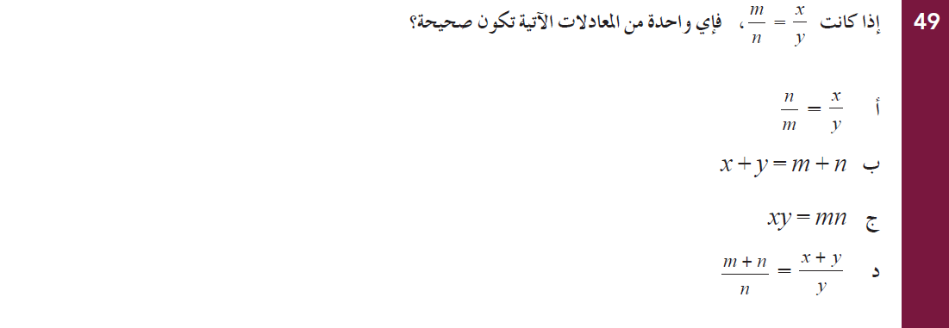
EMSA Math Bilingual / Arabic
Grade 10 - April, 2009

Slide 2
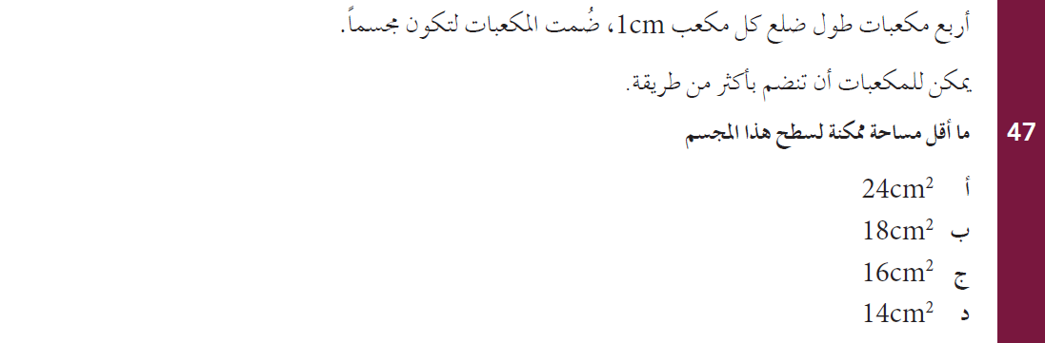
EMSA Math Bilingual / Arabic
Grade 10 - April, 2009

Slide 3
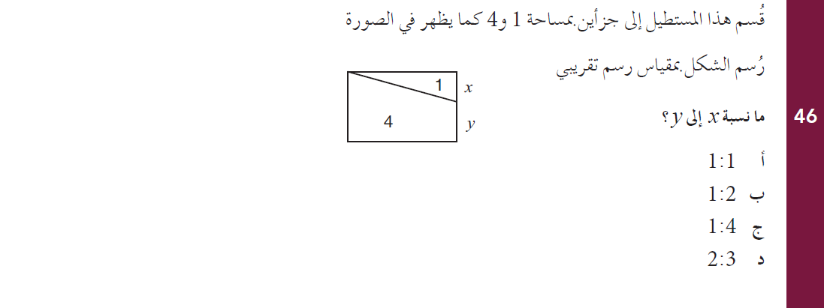
EMSA Math Bilingual / Arabic
Grade 10 - April, 2009

Slide 4
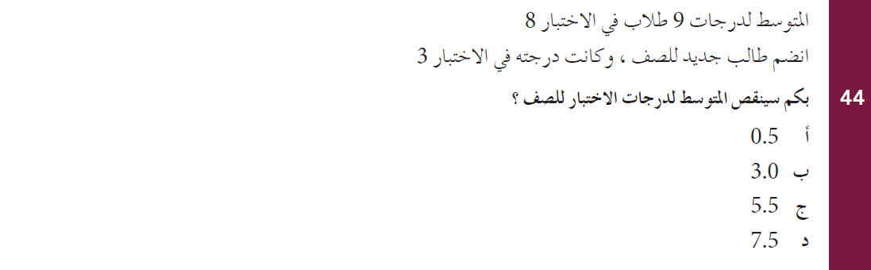
EMSA Math Bilingual / Arabic
Grade 10 - April, 2009

Slide 5
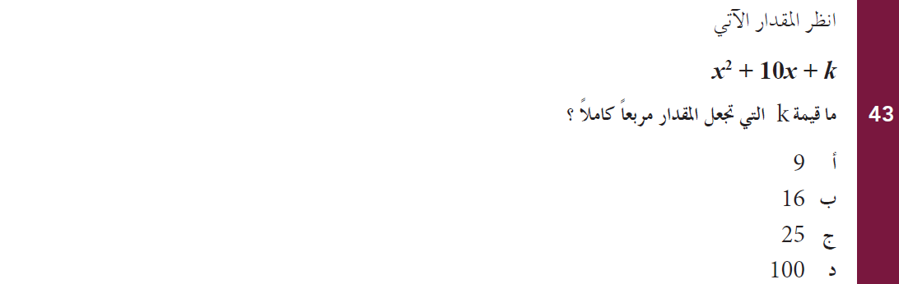
EMSA Math Bilingual / Arabic
Grade 10 - April, 2009

Slide 6
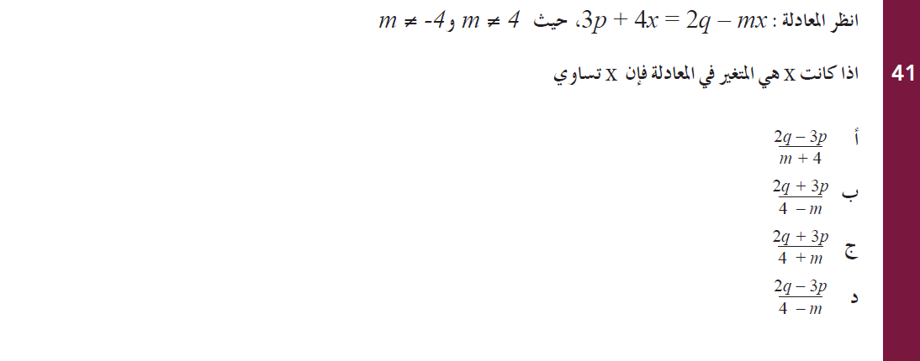
EMSA Math Bilingual / Arabic
Grade 10 - April, 2009

Slide 7
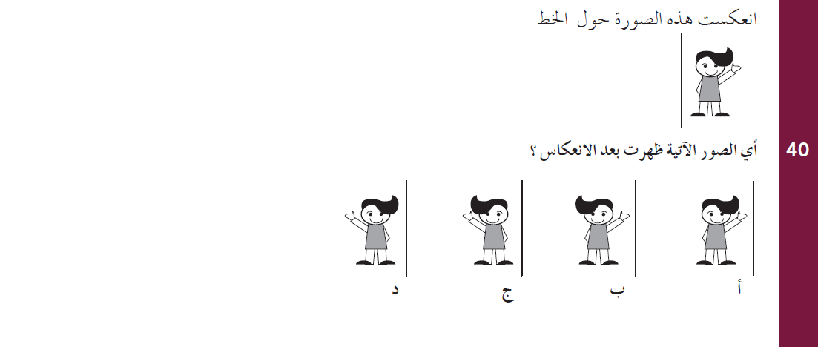
EMSA Math Bilingual / Arabic
Grade 10 - April, 2009

Slide 8
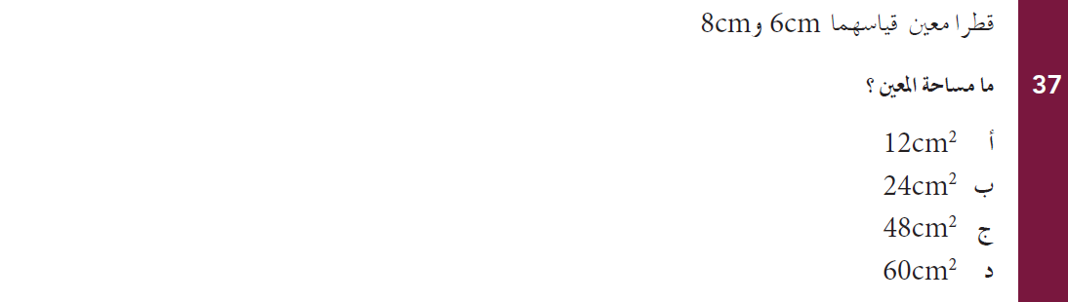
EMSA Math Bilingual / Arabic
Grade 10 - April, 2009

Slide 9
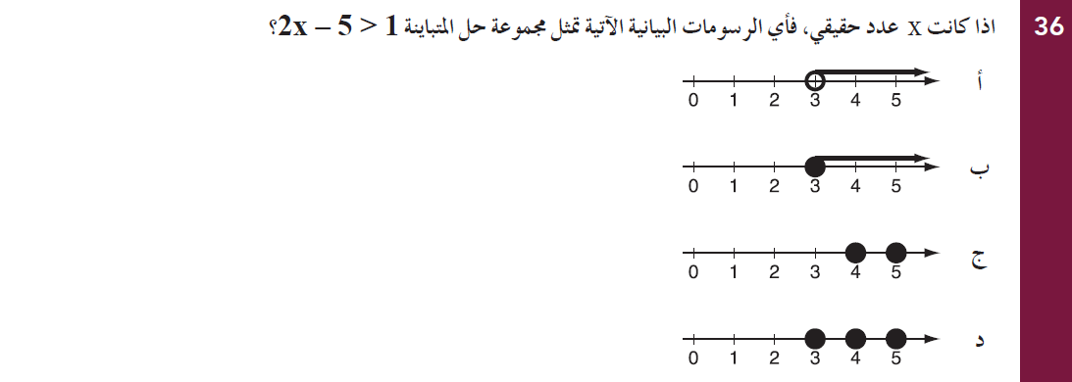
EMSA Math Bilingual / Arabic
Grade 10 - April, 2009

Slide 10
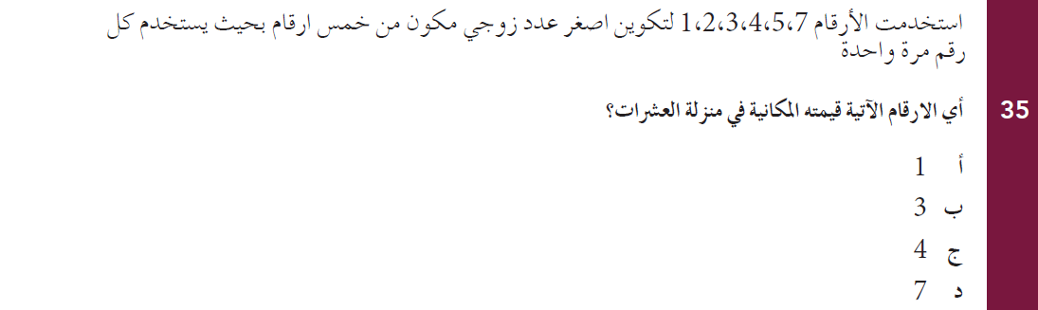
EMSA Math Bilingual / Arabic
Grade 10 - April, 2009

Slide 11
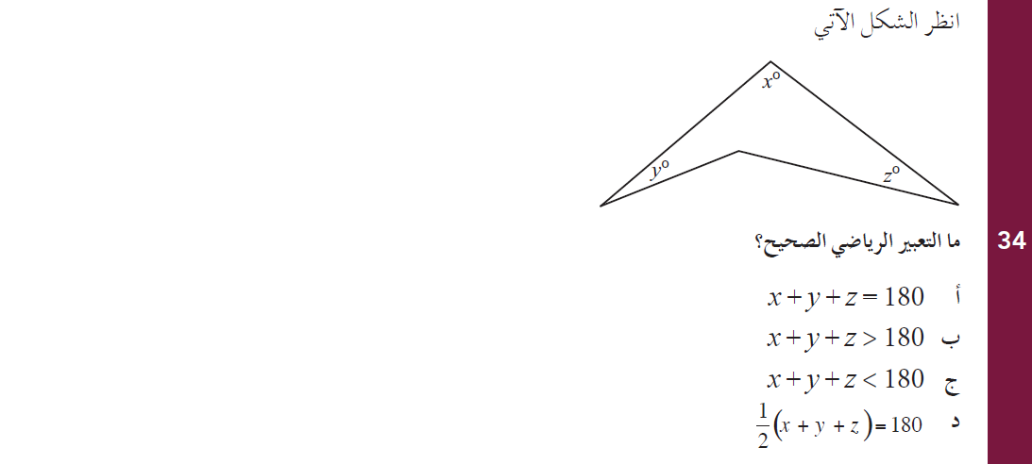
EMSA Math Bilingual / Arabic
Grade 10 - April, 2009

Slide 12
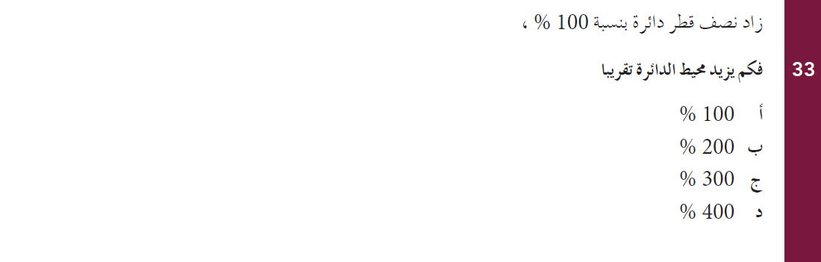
EMSA Math Bilingual / Arabic
Grade 10 - April, 2009

Slide 13
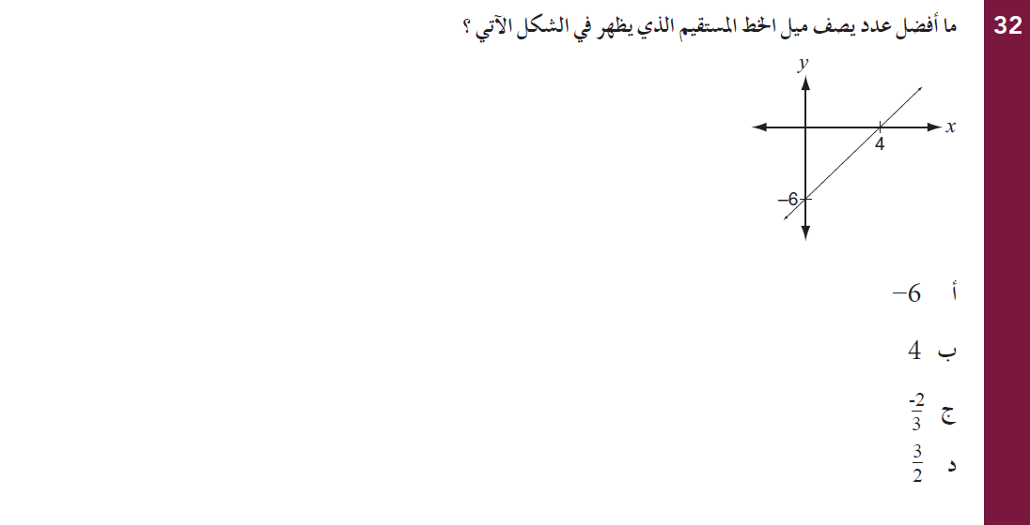
EMSA Math Bilingual / Arabic
Grade 10 - April, 2009

Slide 14
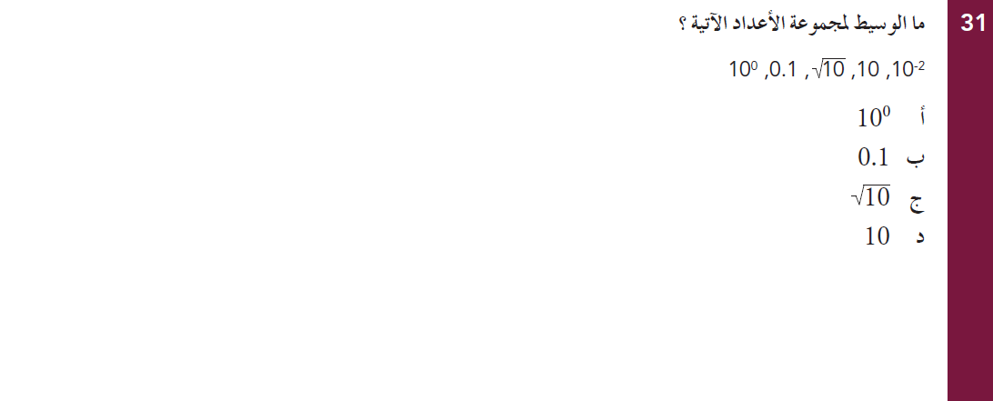
EMSA Math Bilingual / Arabic
Grade 10 - April, 2009

Slide 15
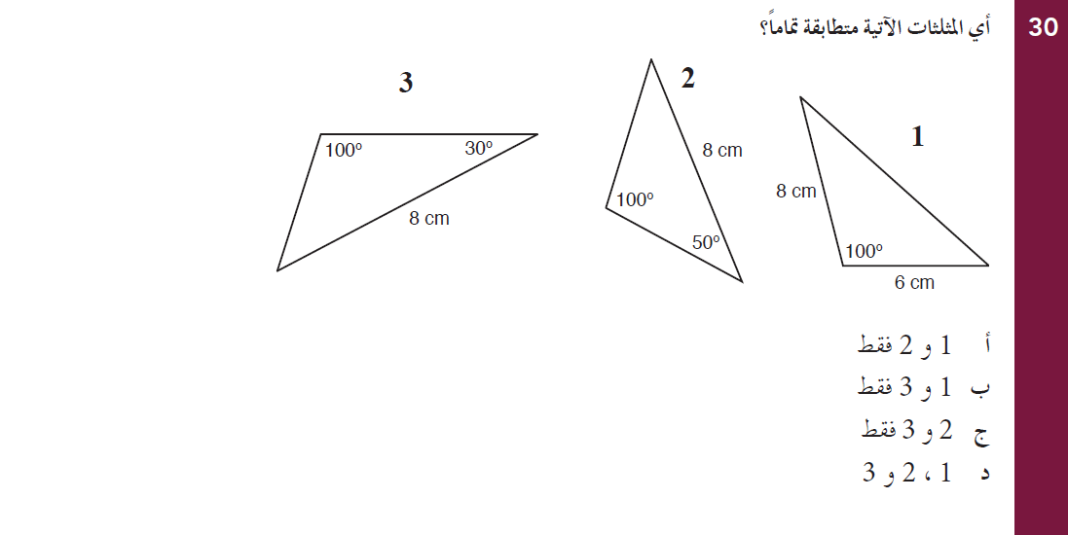
EMSA Math Bilingual / Arabic
Grade 10 - April, 2009

Slide 16
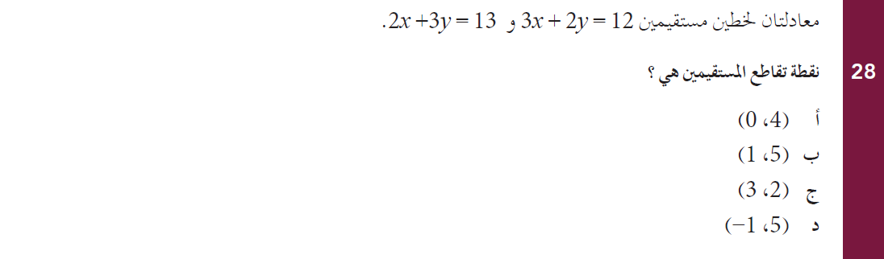
EMSA Math Bilingual / Arabic
Grade 10 - April, 2009

Slide 17
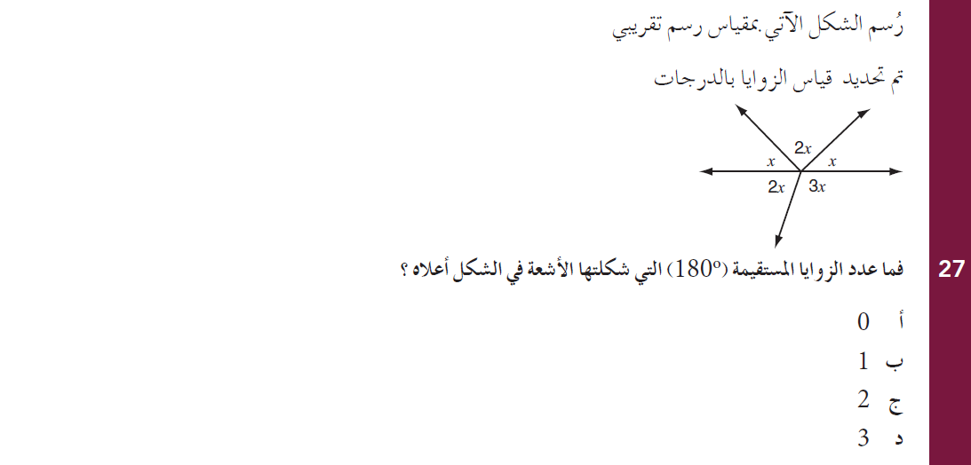
EMSA Math Bilingual / Arabic
Grade 10 - April, 2009

Slide 18
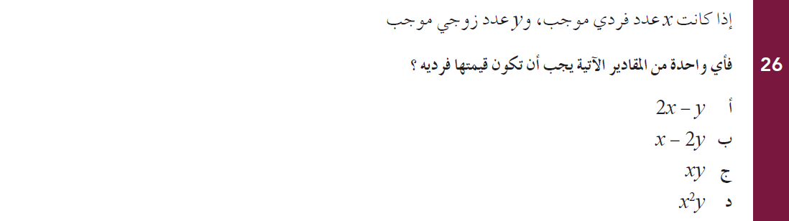
EMSA Math Bilingual / Arabic
Grade 10 - April, 2009

Slide 19
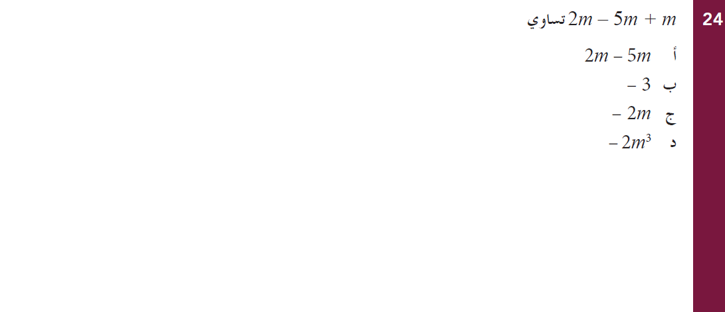
EMSA Math Bilingual / Arabic
Grade 10 - April, 2009

Slide 20
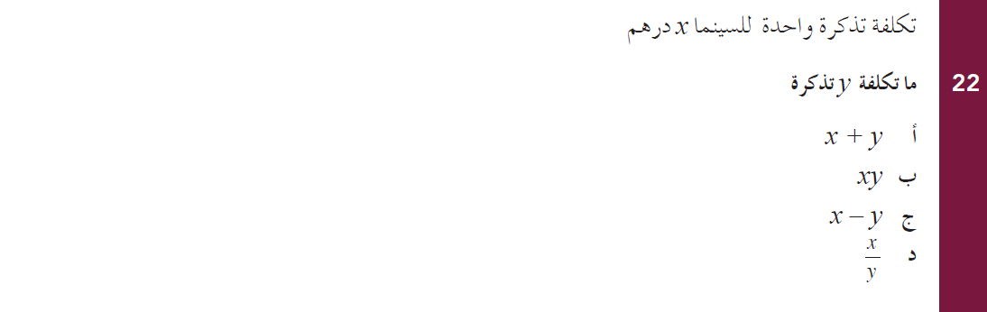
EMSA Math Bilingual /Arabic
Grade 10 - April, 2009

Slide 21
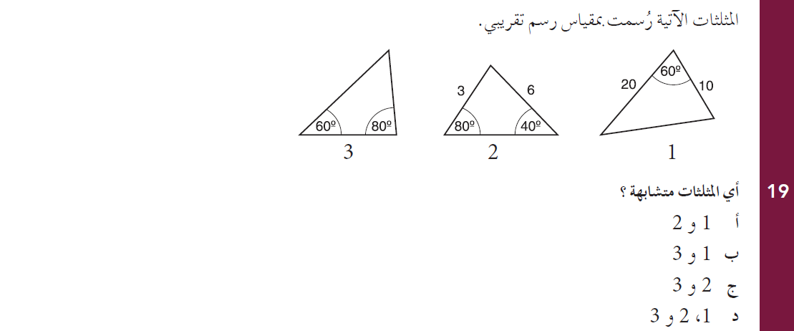
EMSA Math Bilingual / Arabic
Grade 10 - April, 2009

Slide 22
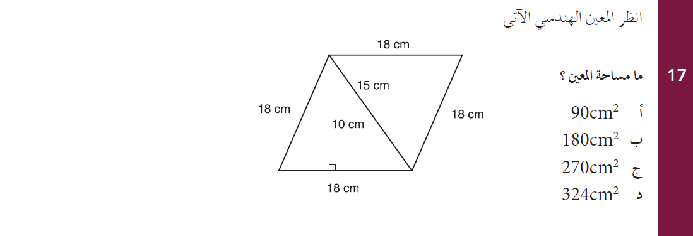
EMSA Math Bilingual / Arabic
Grade 10 - April, 2009

Slide 23
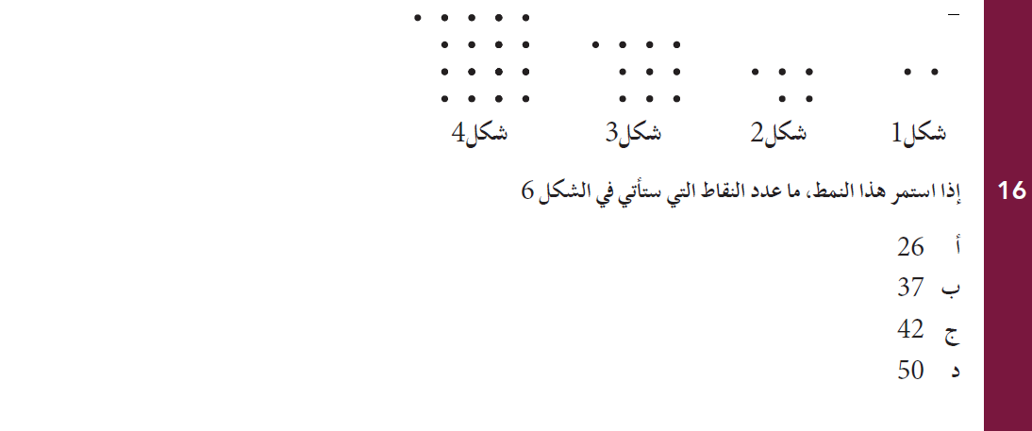
EMSA Math Bilingual / Arabic
Grade 10 - April, 2009

Slide 24
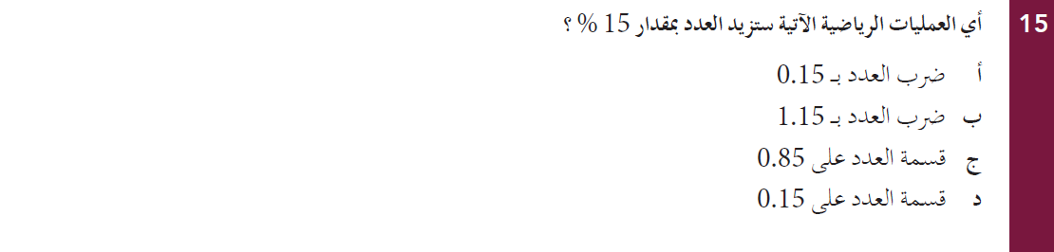
EMSA Math Bilingual / Arabic
Grade 10 - April, 2009

Slide 25
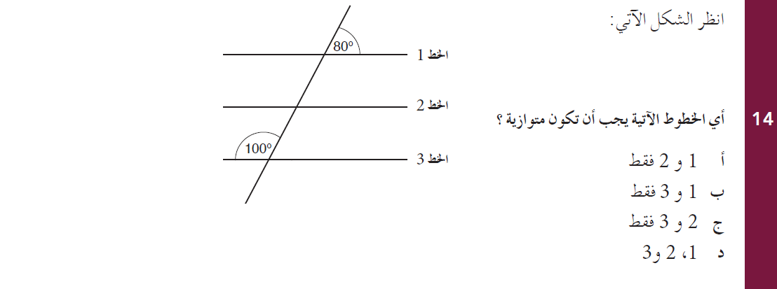
EMSA Math Bilingual / Arabic
Grade 10 - April, 2009

Slide 26
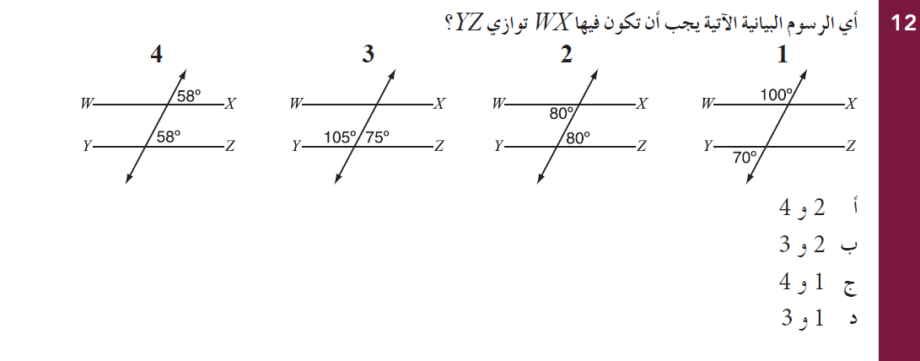
EMSA Math Bilingual / Arabic
Grade 10 - April, 2009

Slide 27
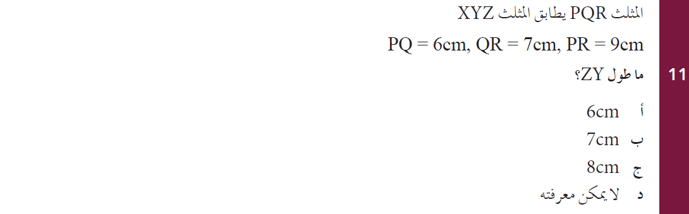
EMSA Math Bilingual / Arabic
Grade 10 - April, 2009

Slide 28
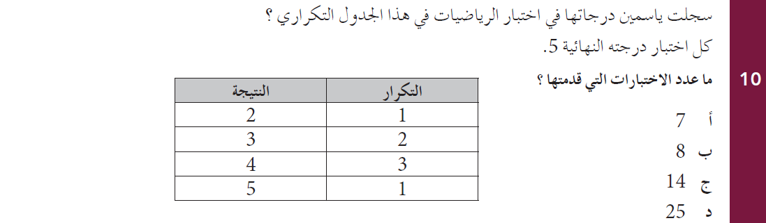
EMSA Math Bilingual / Arabic
Grade 10 - April, 2009

Slide 29
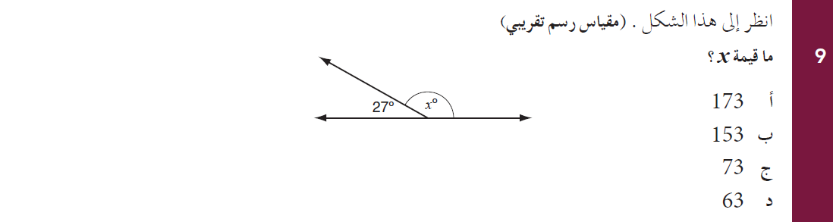
EMSA Math Bilingual / Arabic
Grade 10 - April, 2009

Slide 30
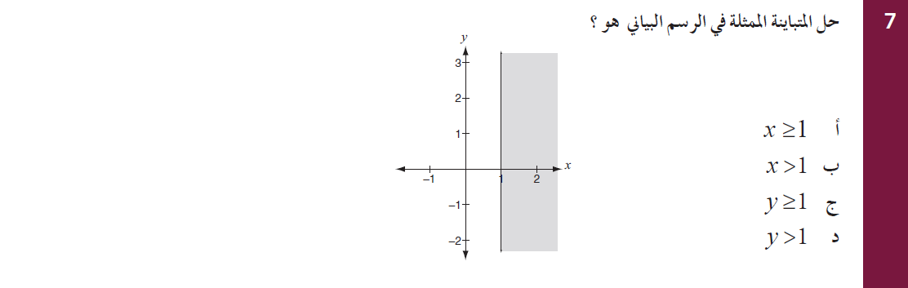
EMSA Math Bilingual / Arabic
Grade 10 - April, 2009

Slide 31
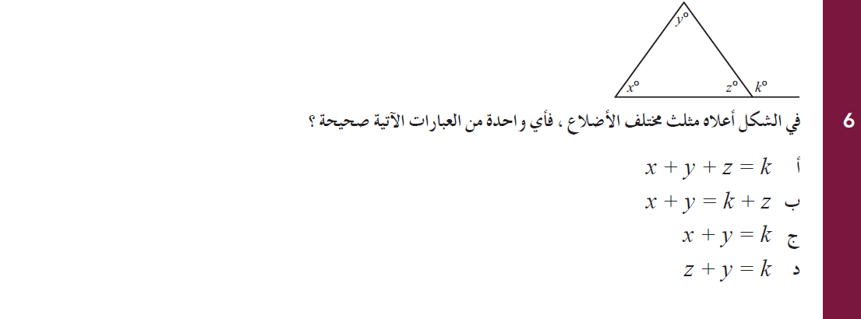
EMSA Math Bilingual / Arabic
Grade 10 - April, 2009

Slide 32
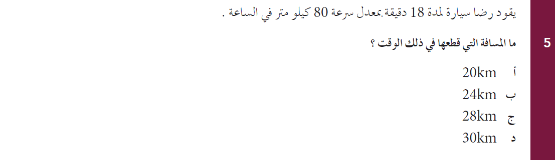
EMSA Math Bilingual / Arabic
Grade 10 - April, 2009

Slide 33
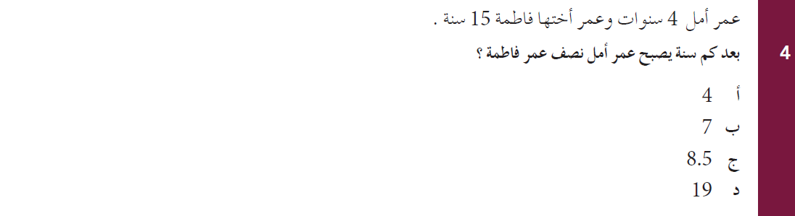
EMSA Math Bilingual / Arabic
Grade 10 - April, 2009

Slide 34
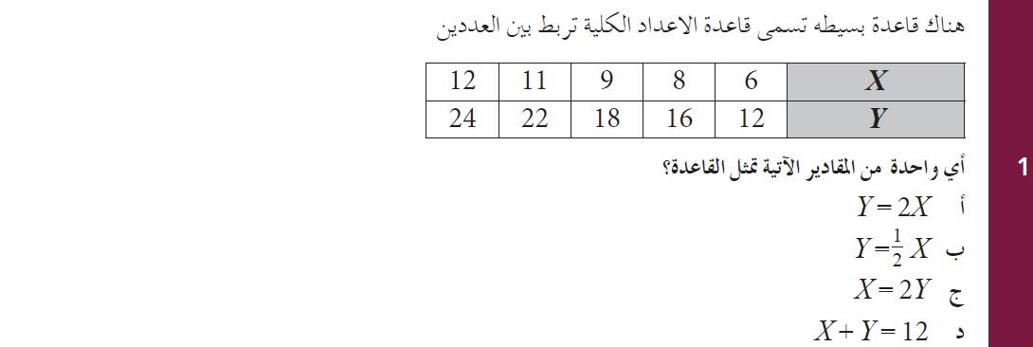
EMSA Math Bilingual /Arabic
Grade 10 - April, 2009

Slide 35
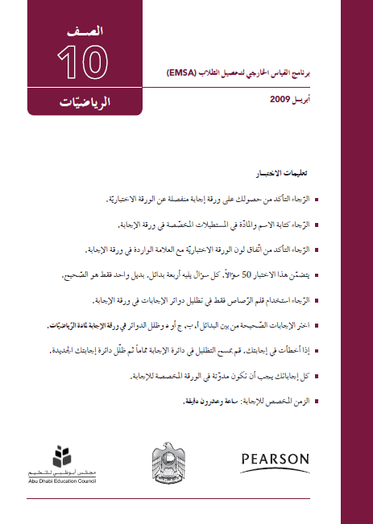
EMSA Math Bilingual / Arabic
Grade 10 - April, 2009
English/Arabic

