Slide 1
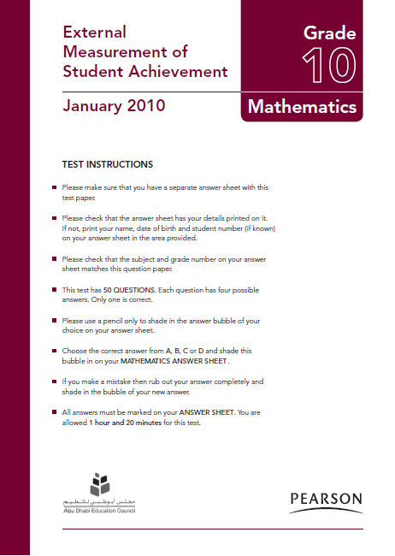
EMSA Math Bilingual
Grade 10 - Jan., 2010
English/Arabic

Slide 2
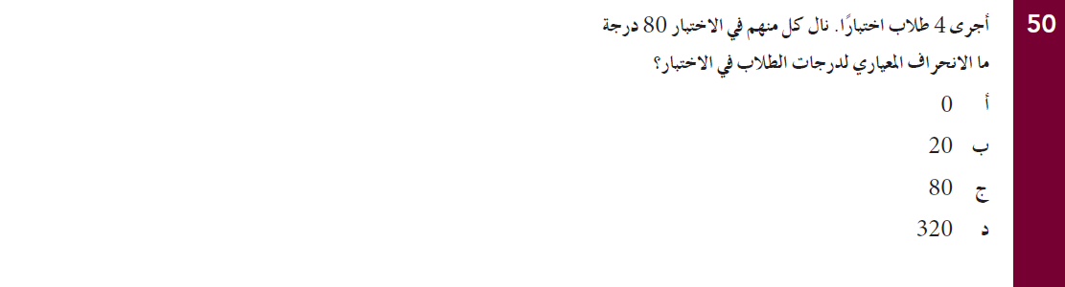
EMSA Math Bilingual / Arabic
Grade 10 - Jan., 2010

Slide 3
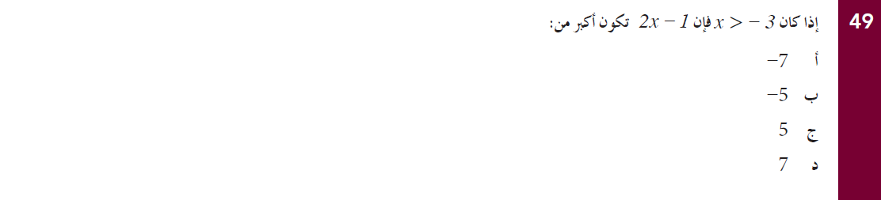
EMSA Math Bilingual / Arabic
Grade 10 - Jan., 2010

Slide 4
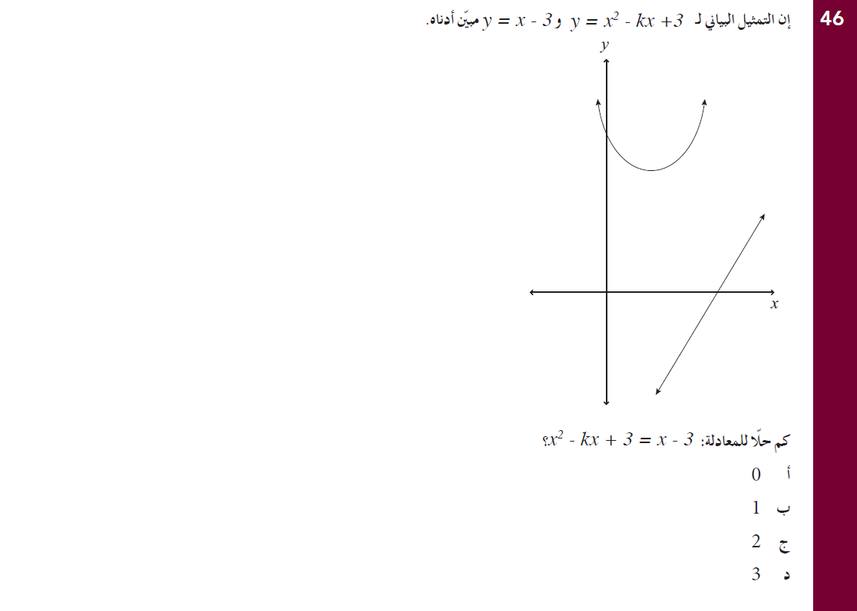
EMSA Math Bilingual / Arabic
Grade 10 - Jan., 2010

Slide 5
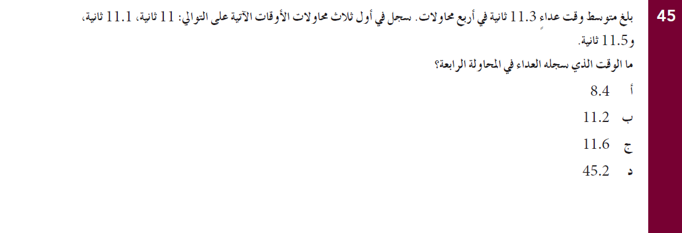
EMSA Math Bilingual / Arabic
Grade 10 - Jan., 2010

Slide 6
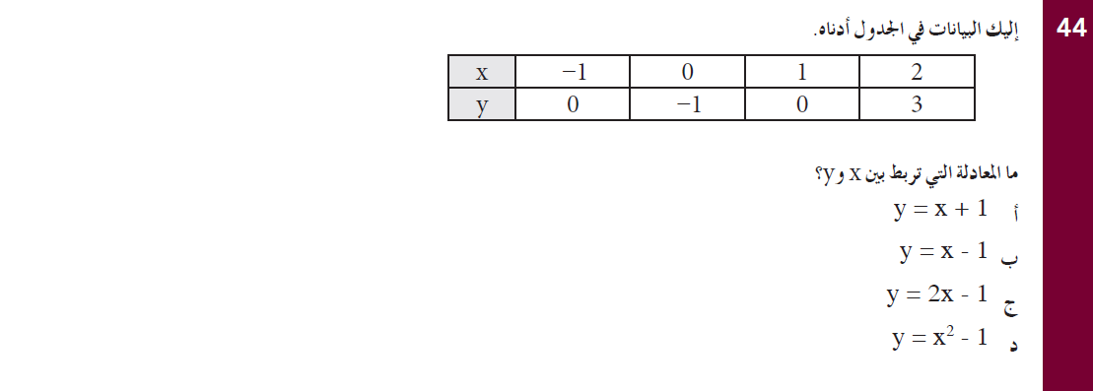
EMSA Math Bilingual / Arabic
Grade 10 - Jan., 2010

Slide 7
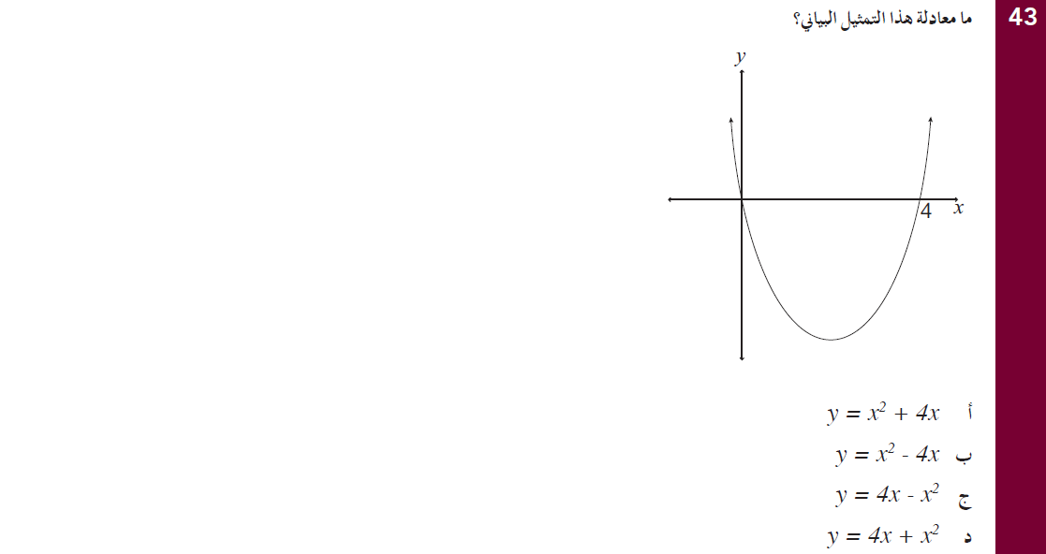
EMSA Math Bilingual / Arabic
Grade 10 - Jan., 2010

Slide 8
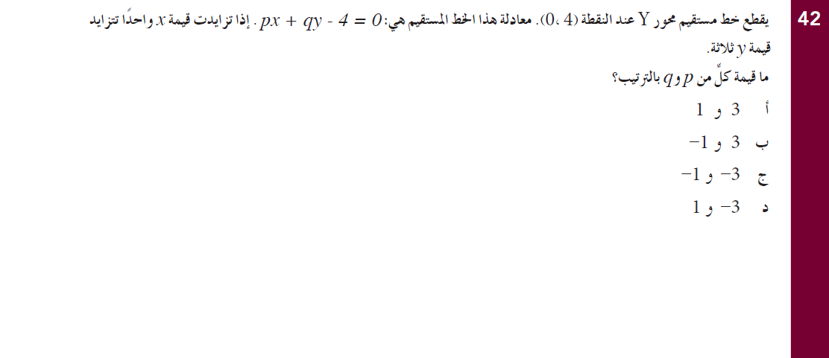
EMSA Math Bilingual / Arabic
Grade 10 - Jan., 2010

Slide 9
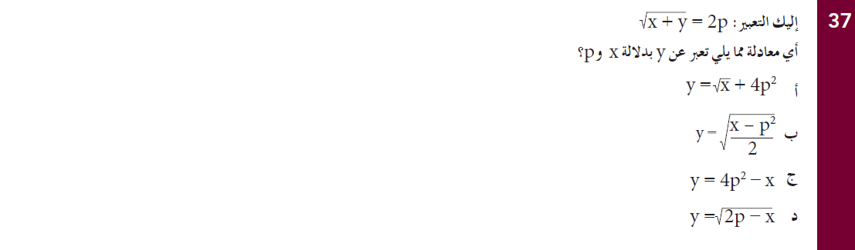
EMSA Math Bilingual / Arabic
Grade 10 - Jan., 2010

Slide 10
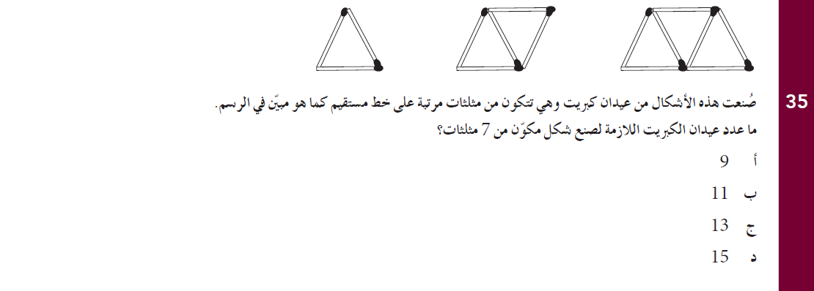
EMSA Math Bilingual / Arabic
Grade 10 - Jan., 2010

Slide 11
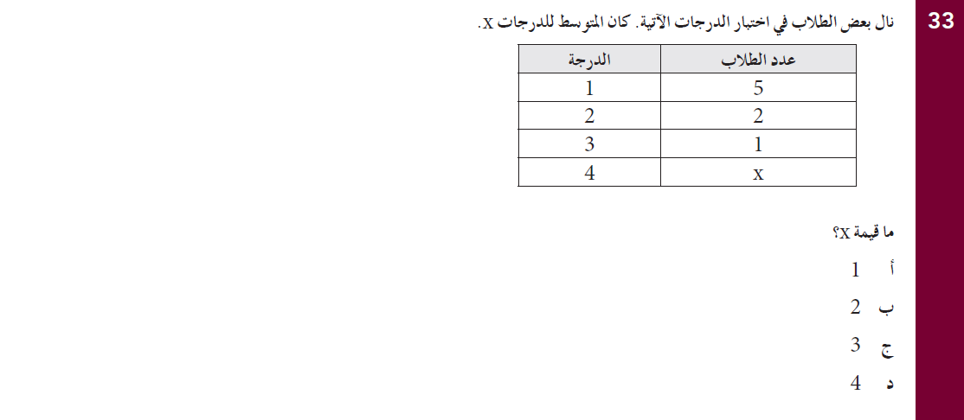
EMSA Math Bilingual / Arabic
Grade 10 - Jan., 2010

Slide 12
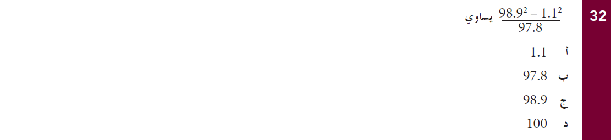
EMSA Math Bilingual / Arabic
Grade 10 - Jan., 2010

Slide 13
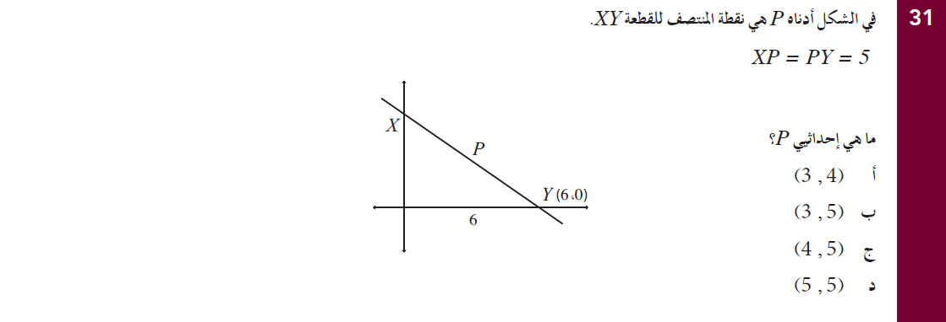
EMSA Math Bilingual / Arabic
Grade 10 - Jan., 2010

Slide 14
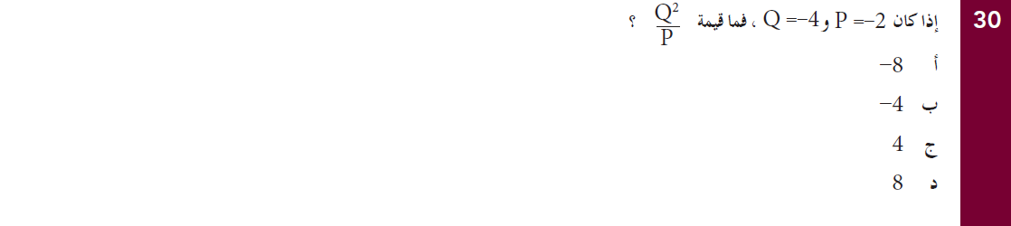
EMSA Math Bilingual / Arabic
Grade 10 - Jan., 2010

Slide 15
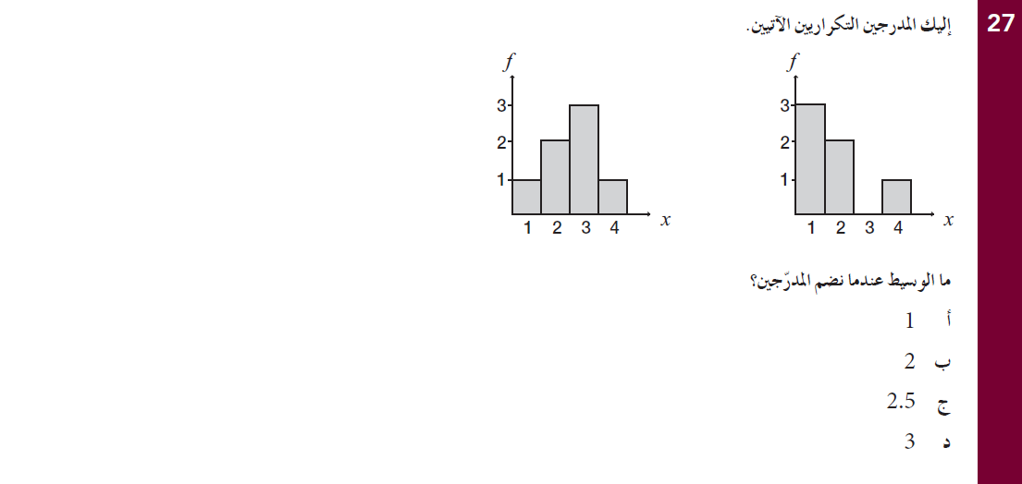
EMSA Math Bilingual / Arabic
Grade 10 - Jan., 2010

Slide 16
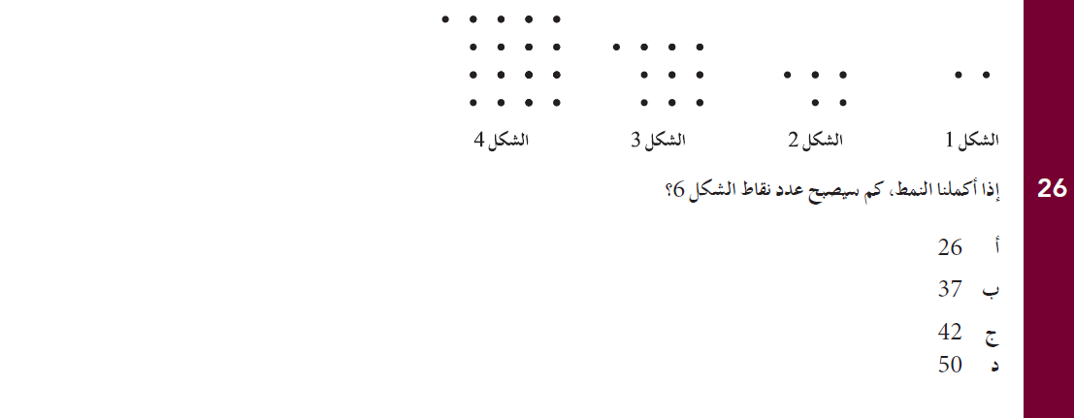
EMSA Math Bilingual / Arabic
Grade 10 - Jan., 2010

Slide 17
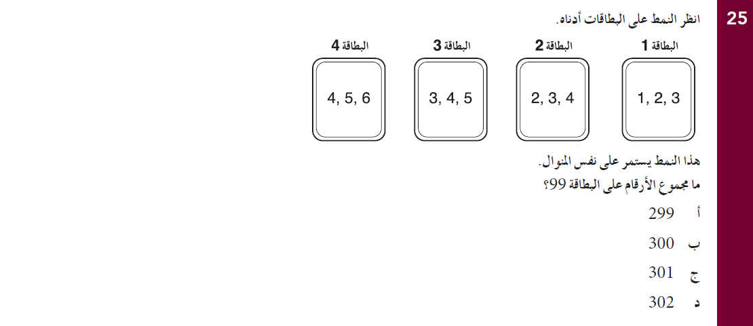
EMSA Math Bilingual / Arabic
Grade 10 - Jan., 2010

Slide 18
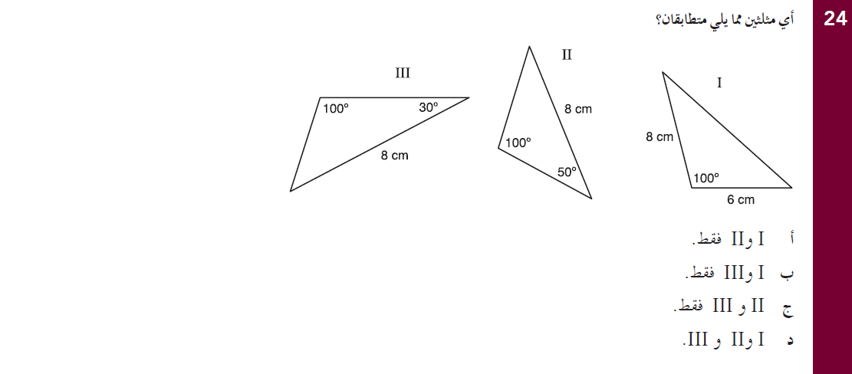
EMSA Math Bilingual / Arabic
Grade 10 - Jan., 2010

Slide 19
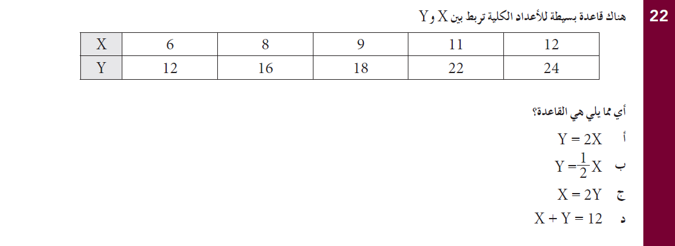
EMSA Math Bilingual /Arabic
Grade 10 - Jan., 2010

Slide 20
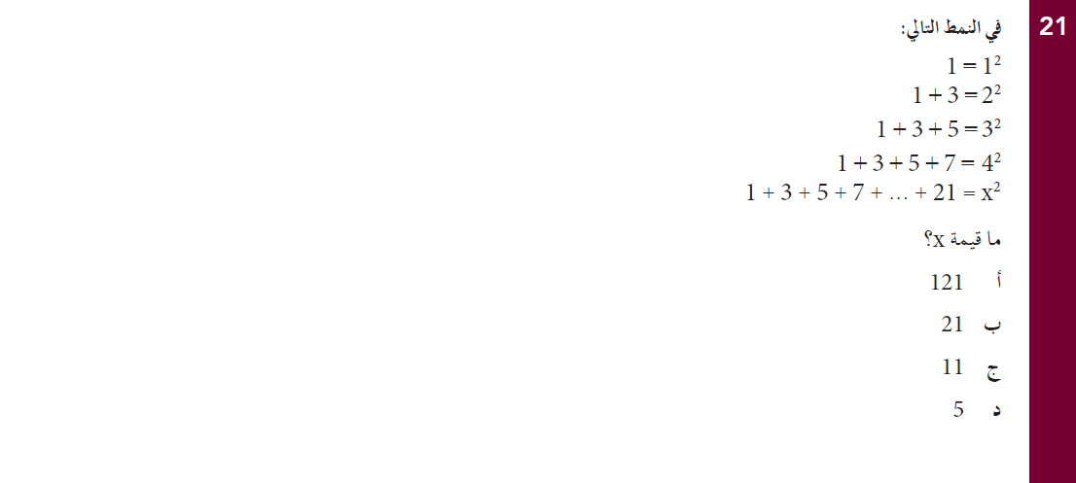
EMSA Math Bilingual / Arabic
Grade 10 - Jan., 2010

Slide 21
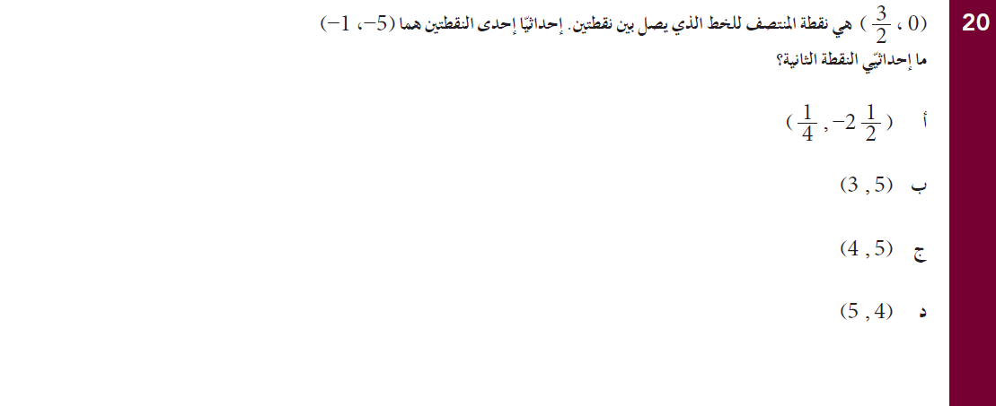
EMSA Math Bilingual / Arabic
Grade 10 - Jan., 2010

Slide 22
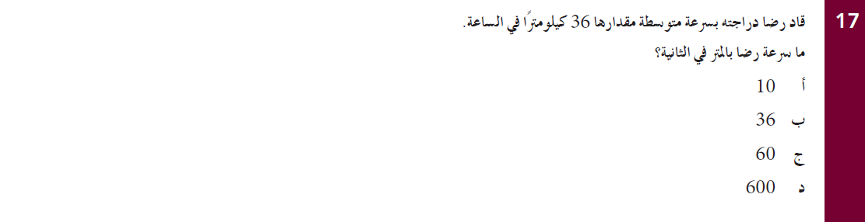
EMSA Math Bilingual / Arabic
Grade 10 - Jan., 2010

Slide 23
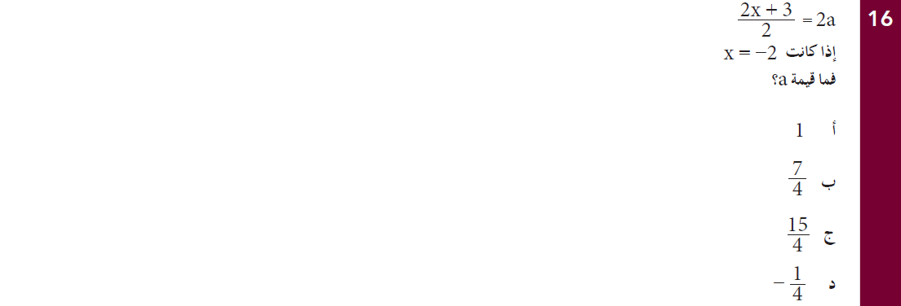
EMSA Math Bilingual / Arabic
Grade 10 - Jan., 2010

Slide 24
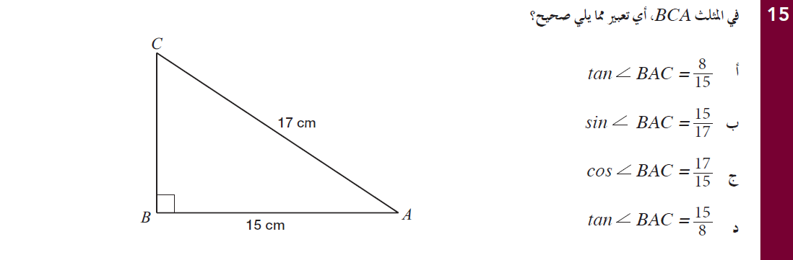
EMSA Math Bilingual / Arabic
Grade 10 - Jan., 2010

Slide 25
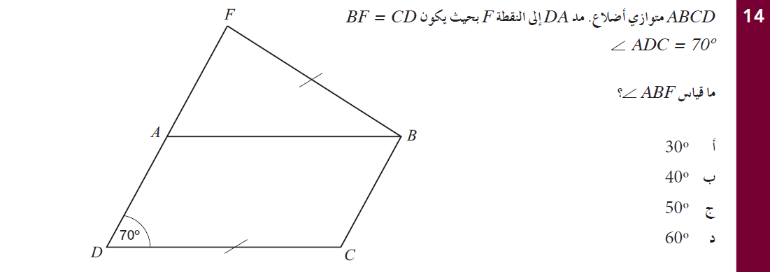
EMSA Math Bilingual / Arabic
Grade 10 - Jan., 2010

Slide 26
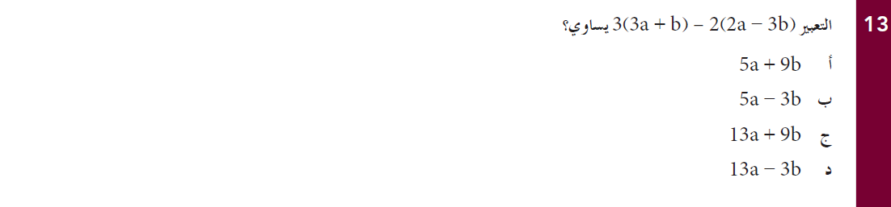
EMSA Math Bilingual / Arabic
Grade 10 - Jan., 2010

Slide 27
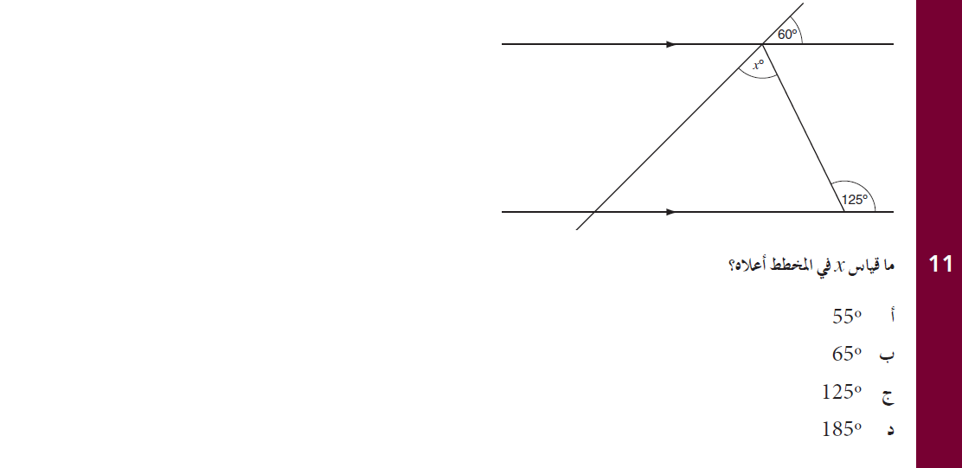
EMSA Math Bilingual / Arabic
Grade 10 - Jan., 2010

Slide 28
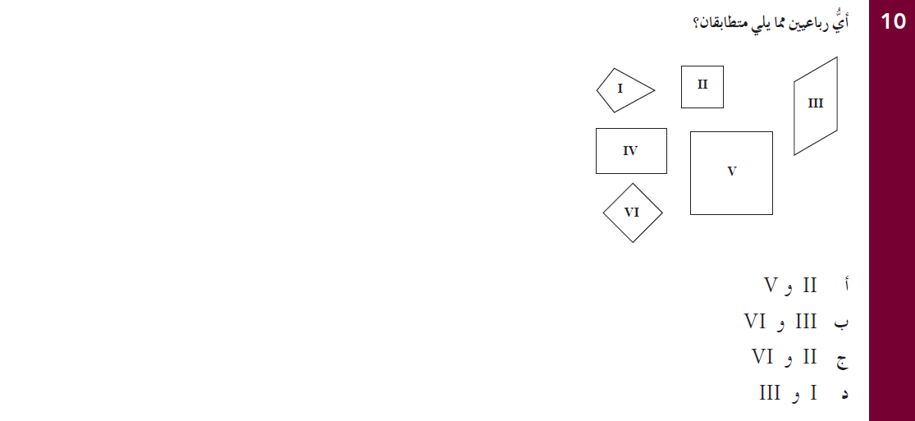
EMSA Math Bilingual / Arabic
Grade 10 - Jan., 2010

Slide 29
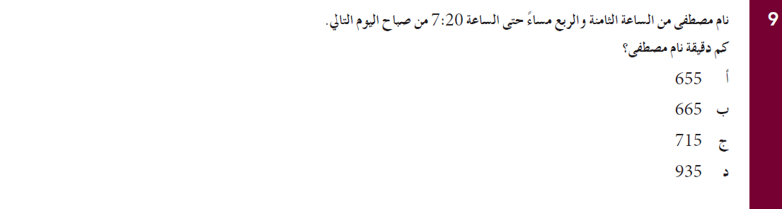
EMSA Math Bilingual / Arabic
Grade 10 - Jan., 2010

Slide 30
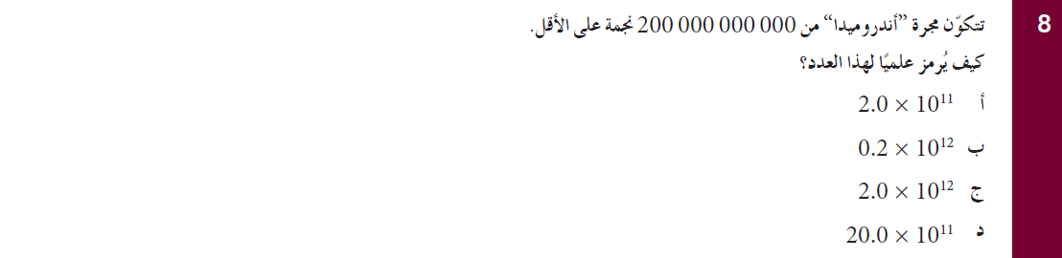
EMSA Math Bilingual / Arabic
Grade 10 - Jan., 2010

Slide 31
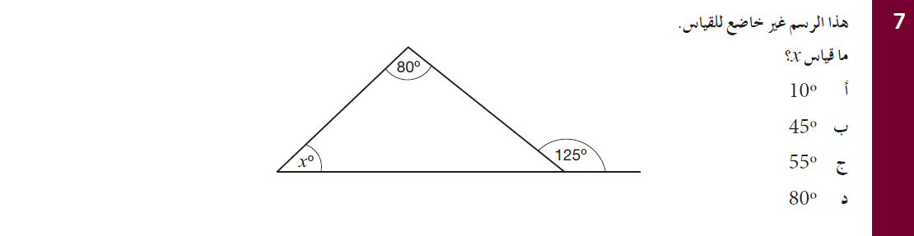
EMSA Math Bilingual / Arabic
Grade 10 - Jan., 2010

Slide 32
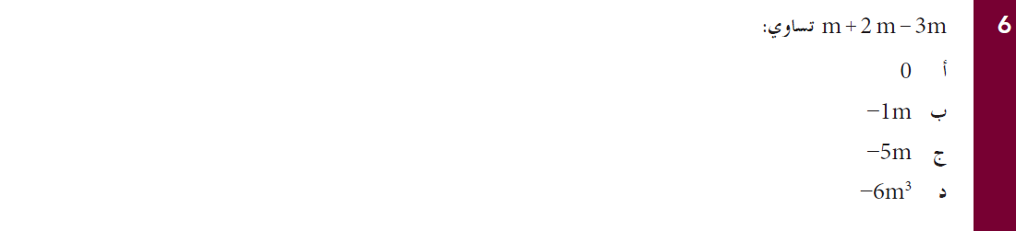
EMSA Math Bilingual / Arabic
Grade 10 - Jan., 2010

Slide 33
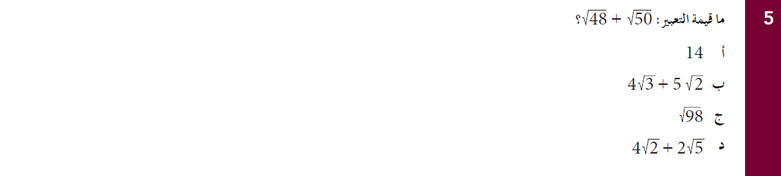
EMSA Math Bilingual / Arabic
Grade 10 - Jan., 2010

Slide 34
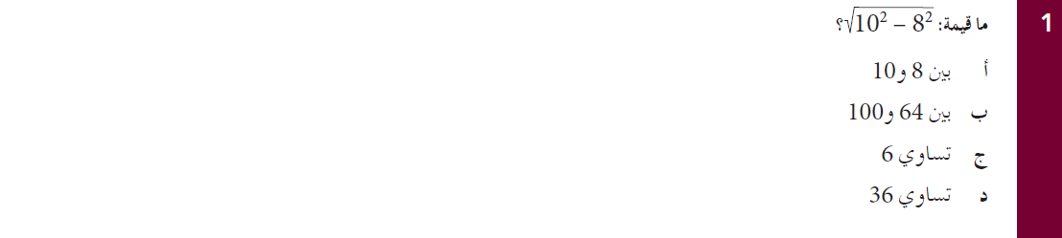
EMSA Math Bilingual /Arabic
Grade 10 - Jan., 2010

