Slide 1
Grade 12
Mathematics
Domain/Range

Slide 2
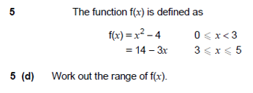
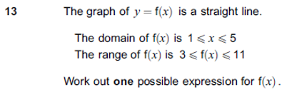
OVERVIEW
#1: Understanding of functions
#2: Domain/Range of common functions (particularly quadratic and trigonometric)
#3: Domain/Range of other functions
#4: Constructing a function based on a given domain/range.

Slide 3
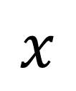
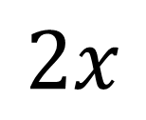
Functions
A function is something which provides a rule on how to map inputs to outputs.
From primary school you might have seen this as a ‘number machine’.
Name of the function (usually $f$ or $g$)
Input
Output
$$f(x)=2x$$
Input
Output
$$x$$
f
$$2x$$

Slide 4
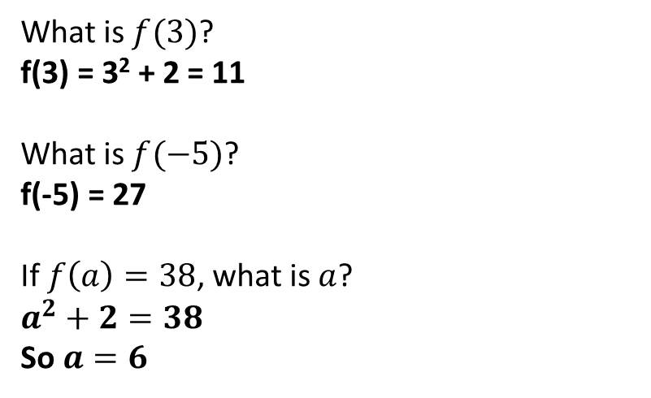
Check Your Understanding
$$f(x)=x2+2$$
Q1
What does this function do?
It squares the input then adds 2 to it.
?
Q2
What is $f(3)$?
f(3) = 3² + 2 = 11
What is $f(−5)$?
f(-5) = 27
If $f\left(a\right)=38$, what is $a$?
$a^{2}+2=38$
So $a=6$
?
Q3
?
Q4
?

Slide 5
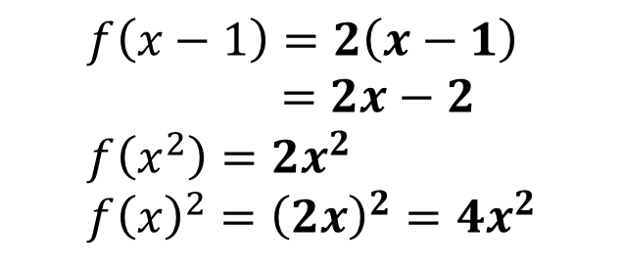

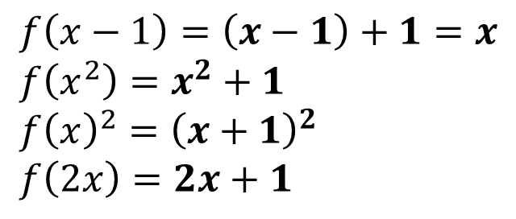
Algebraic Inputs
If you change the input of the function ($x$), just replace each occurrence of $x$ in the output.
If $f\left(x\right)=x+1$ what is:
If $f\left(x\right)=x^{2}−1$ what is:
?
$$f\left(x−1\right)=\left(x−1\right)+1=x \\ f\left(x^{2}\right)=x^{2}+1 \\ f{\left(x\right)}^{2}={\left(x+1\right)}^{2} \\ f\left(2x\right)=2x+1$$
$$f\left(x−1\right)={\left(x−1\right)}^{2}−1 \\ =x^{2}−2x \\ f\left(2x\right)={\left(2x\right)}^{2}−1 \\ =4x^{2}−1 \\ f\left(x^{2}+1\right)={\left(x^{2}+1\right)}^{2}−1 \\ =x^{4}+2x^{2}$$
?
?
?
?
?
?
If $f\left(x\right)=2x$ what is:
$$f\left(x−1\right)=2\left(x−1\right) \\ =2x−2 \\ f\left(x^{2}\right)=2x^{2} \\ f{\left(x\right)}^{2}={\left(2x\right)}^{2}=4x^{2}$$
?
?
?

Slide 6
Test Your Understanding
A
If $g\left(x\right)=3x−1$, determine:
$g\left(x−1\right)=3\left(x−1\right)−1=3x−4$
$g\left(2x\right)=3\left(2x\right)−1=6x−1$
$g\left(x^{3}\right)=3x^{3}−1$
?
?
?
B
If $f\left(x\right)=2x+1$, solve $f\left(x^{2}\right)=51$
$$2x^{2}+1=51 \\ x=±5$$
?

Slide 7
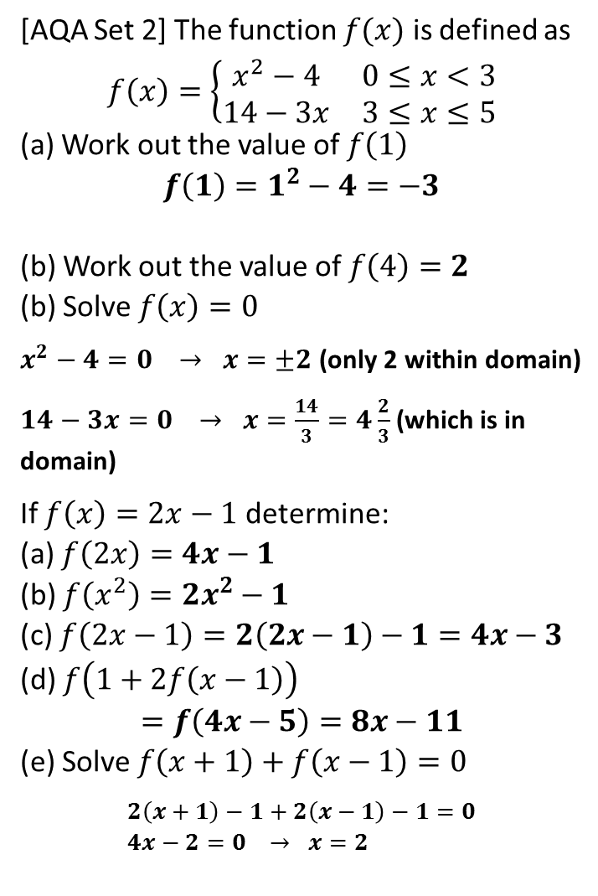

Exercise 1
(exercises on provided sheet)
1
[AQA Worksheet] $f\left(x\right)=2x^{3}−250$. Work out $x$ when $f\left(x\right)=0$
$$2x^{3}−250=0 → x=5$$
[AQA Worksheet] $f\left(x\right)=x^{2}+ax−8$. If $f\left(−3\right)=13$, determine the value of $a$.
$$9−3a−8=13 \\ a=−4$$
[AQA Worksheet] $f\left(x\right)=x^{2}+3x−10$ Show that $f\left(x+2\right)=x\left(x+7\right)$
$$f\left(x+2\right)={\left(x+2\right)}^{2}+3\left(x+2\right)−10 \\ =x^{2}+4x+4+3x+6−10 \\ =x^{2}+7x=x\left(x+7\right)$$
[June 2012 Paper 2] $f\left(x\right)=3x−5$ for all values of $x$. Solve $f\left(x^{2}\right)=43$
$$3x^{2}−5=43 \\ x=±4$$
5
[AQA Set 2] The function $f(x)$ is defined as $$f\left(x\right)=\left\{\begin{matrix}x^{2}−4 & 0≤x<3 \\ 14−3x & 3≤x≤5\end{matrix}\right.$$ (a) Work out the value of $f\left(1\right)$ $$f\left(1\right)=1^{2}−4=−3$$ (b) Work out the value of $f\left(4\right)=2$ (b) Solve $f\left(x\right)=0$
$x^{2}−4=0 → x=±2$ (only 2 within domain)
$14−3x=0 → x=\frac{14}{3}=4\frac{2}{3}$ (which is in domain)
If $f\left(x\right)=2x−1$ determine: (a) $f\left(2x\right)=4x−1$ (b) $f\left(x^{2}\right)=2x^{2}−1$ (c) $f\left(2x−1\right)=2\left(2x−1\right)−1=4x−3$ (d) $f\left(1+2f\left(x−1\right)\right)$ $$=f\left(4x−5\right)=8x−11$$ (e) Solve $f\left(x+1\right)+f\left(x−1\right)=0$
$$2\left(x+1\right)−1+2\left(x−1\right)−1=0 \\ 4x−2=0 → x=2$$
?
2
?
?
?
?
3
?
6
?
?
4
?
?
?
?

