Slide 2
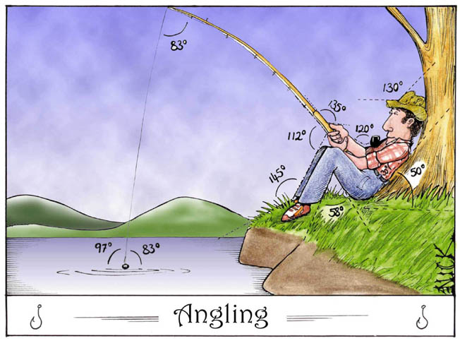

Slide 3
Trigonometry
Right Triangle Trigonometry:

Slide 4
Relating to the Real World
Before any spacecraft ever traveled to another planet, astronomers had figured out the distance from each planet to the sun. They accomplished this feat by using trigonometry the mathematics of triangle measurement. You will learn how to use trigonometry to measure distances that you could never otherwise measure.

Slide 5
Instant Trig
Trigonometry is math, so many people find it scary
It’s usually taught in high-school course
However, 95% of all the “trig” you’ll ever need to know can be covered in 15 minutes
And that’s what we’re going to do now

Slide 6
Angles add to 180°
The angles of a triangle always add up to 180°
20°
44°
30°
68°
68°
120°
20°
44°
30°
68°
+ 130°
+ 68°
180°
180°

Slide 7
Right triangles
We only care about right triangles
A right triangle is one in which one of the angles is 90°
Here’s a right triangle:
Here’s the angle
we are looking at
Here’s the
right angle
hypotenuse
opposite
adjacent
We call the longest side the hypotenuse
We pick one of the other angles--not the right angle
We name the other two sides relative to that angle

Slide 8
Introduction to Trigonometry
In this section we define the three basic trigonometric ratios, sine, cosine and tangent.
opp is the side opposite angle A
adj is the side adjacent to angle A
hyp is the hypotenuse of the right triangle
hyp
opp
adj
A

Slide 9
Introduction
Definitions
In Sec 2,you have learnt to apply the trigonometric ratios to right angled triangles.
hyp
opp
A
adj

Slide 10
The Pythagorean Theorem
If you square the length of the two shorter sides and add them, you get the square of the length of the hypotenuse
adj² + opp² = hyp²
3² + 4² = 5², or 9 + 16 = 25

Slide 11
5-12-13
There are few triangles with integer sides that satisfy the Pythagorean formula
3-4-5 and its multiples (6-8-10, etc.) are the best known
5-12-13 and its multiples form another set
opp
hyp
adj
25 + 144 = 169

Slide 13
Worksheet

Slide 14
Right triangles

Slide 15
Right triangles

Slide 16
Right triangles

Slide 17
Right triangles

Slide 18
Right triangles

Slide 19
Right triangles

Slide 20
Right triangles

Slide 21
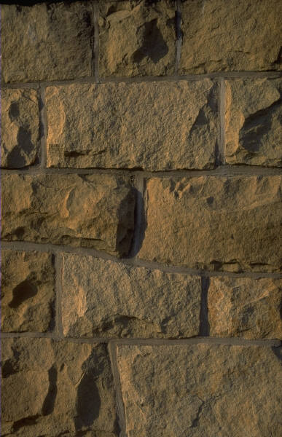
PYTHAGOREAN APPLICATIONS
e.g. A ladder 5 m long is placed against the wall. The base of the ladder is 2 m from the wall.
Draw a diagram to show this information and calculate how high up the wall the ladder reaches.
Wall (x)
Ladder (5 m)
x² + 2² = 5²
5² = x² + 2²
x² = 5² - 2²
-2²
-2²
x² = 21
x = √21
x = 4.58 m (2 d.p.)
Base (2 m)

Slide 22
Word Splash
Use your prior knowledge or make up a meaning for the following words to create a story. Use your imagination!
Cosine
جيب التمام الزاوية
Surveying
المسح
Corresponding
المقابلة
scale factor
عامل المقياس
Astronomy
علم الفلك
Hypotenuse
وتر المثلث
Similar
مماثل
direct measurement
القياس المباشر
Congruent
منسجم
trigonometric ratios
النسب المثلثية
angle of depression
زاوية الانخفاض
angle of elevation
زاوية الارتفاع
Tangent
المماس – ظل الزاوية
Sine
جيب الزاوية

Slide 23
TRIGONOMETRY (SIN, COS & TAN)
- Label the triangle as follows, according to the angle being used.
to remember the trig ratios use
Hypotenuse (H)
SOH CAH TOA
Opposite (O)
and the triangles
A
Always make sure your calculator is set to degrees!!
Adjacent (A)
O
A
O
S
H
C
H
T
A
means divide
1. Calculating Sides
means multiply
e.g.
7.65 m
O
x
H
h
T
A
O
O
29°
50°
h = tan50 x 6.5
O
6.5 cm
A
x = sin29 x 7.65
h = 7.75 cm (2 d.p.)
S
H
x = 3.71 m (2 d.p.)

Slide 24
e.g.
O
d = 455 ÷ sin32
d
H
455 m
d = 858.62 m (2 d.p.)
O
S
H
32°
Inverses
- are used when calculating angles.
- are found above the sin, cos and tan buttons so the ‘shift’ or 2nd function is needed
e.g. Find angle A if sin A = 0.1073
sin⁻¹ undoes sin
sin⁻¹
A = sin⁻¹(0.1073)
sin⁻¹
A = 6.2° (1 d.p.)
e.g. Find angle B if tan B = ¾
tan⁻¹ undoes tan
tan⁻¹
B = tan⁻¹(¾)
tan⁻¹
If using the fraction button, you may need to use brackets!
B = 36.9° (1 d.p.)

Slide 25
2. Calculating Angles
-Same method as when calculating sides, except we use inverse trig ratios.
e.g.
23.4 mm
B
4.07 m
sin⁻¹ undoes sin
2.15 m
H
16.1 mm
H
O
A
A
sinA = 16.1 ÷ 23.4
cosB = 2.15 ÷ 4.07
O
A
A = sin⁻¹(16.1 ÷ 23.4)
B = cos⁻¹(2.15 ÷ 4.07)
S
H
C
H
B = 58.1° (1 d.p.)
A = 43.5° (1 d.p.)
Don’t forget brackets, and fractions can also be used

Slide 26
TRIGONOMETRY APPLICATIONS
e.g. A ladder 4.7 m long is
leaning against a wall. The
angle between the wall and
ladder is 27°.
Draw a diagram and find the
height the ladder extends up
the wall.
Wall (x)
A
C
H
27°
A
Ladder (4.7 m)
H
x = cos27 x 4.7
x = 4.19 m (2 d.p.)
A
e.g. A vertical mast is held by a
48 m long wire. The wire is
attached to a point 32 m up
the mast.
Draw a diagram and find the
angle the wire makes with
the mast.
C
H
H
A
48 m
32 m
cosA = 32 ÷ 48
A
A = cos⁻¹(32 ÷ 48)
A = 48.2° (1 d.p.)

Slide 28
Example
Write the Tangent Ratios for < U and < T.
Tan U = opposite = TV = 3 adjacent UV 4
T
5
Tan T = opposite = UV = 4 adjacent TV 3
3
V
4
U

Slide 29
Try This
Write the Tangent ratios for < K and < J
How is Tan K related to the Tan J ?
J
3
K
L
7

Slide 30
Try This: Find the Tangent of < A to the nearest tenth
1. 2.
Hint: Find the Ratio First!
A
4
8
5
A
4

Slide 31
Practice:
Find the Tan A and Tan B ratios of each triangle.
B
5
2
3
5
B
A
A
4
4
B
7
6
5
B
A
A
10

Slide 32
Example
Write the Sine Ratios for < U and < T.
Sin U = opposite = TV = 3 hypotenuse TU 5
T
5
Sin T = opposite = UV = 4 hypotenuse TU 5
3
V
4
U

Slide 33
Try This
Write the Sine ratios for < K and < J
J
10
6
K
L
8

Slide 34
Practice:
Find the Sin A and Sin B ratios of each triangle.
B
4
2
3
5
B
A
A
4
5
B
7
8
7
B
A
A
10

Slide 35
Example
Write the Cosine Ratios for < U and < T.
Cos U = adjacent = UV = 4 hypotenuse TU 5
T
5
Cos T = adjacent = TV = 3 hypotenuse TU 5
3
V
4
U

Slide 36
Try This
Write the Cosine ratios for < K and < J
J
10
6
K
L
8

Slide 37
Practice:
Find the Cos A and Cos B ratios of each triangle.
B
4
2
3
5
B
A
A
4
5
B
7
6
5
B
A
A
10

Slide 38
TRIGONOMETRY (SIN, COS & TAN)

Slide 39
TRIGONOMETRY (SIN, COS & TAN)

Slide 40
TRIGONOMETRY (SIN, COS & TAN)

Slide 41
TRIGONOMETRY (SIN, COS & TAN)

Slide 42
TRIGONOMETRY (SIN, COS & TAN)

Slide 43
TRIGONOMETRY (SIN, COS & TAN)

Slide 44
TRIGONOMETRY (SIN, COS & TAN)

Slide 45
TRIGONOMETRY (SIN, COS & TAN)

Slide 46
Practice:
Use the Cos⁻¹ and Sin ⁻¹ ratios to find the angles of each triangle.
B
5
2
3
6
B
A
A
4
B
7
6
7
B
A
A
10

Slide 47
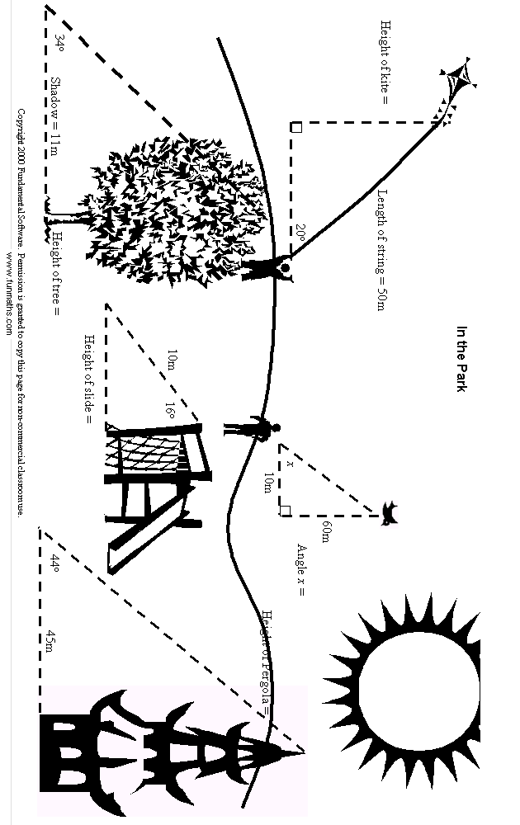

Slide 48
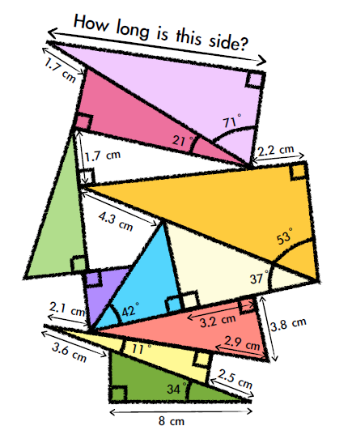
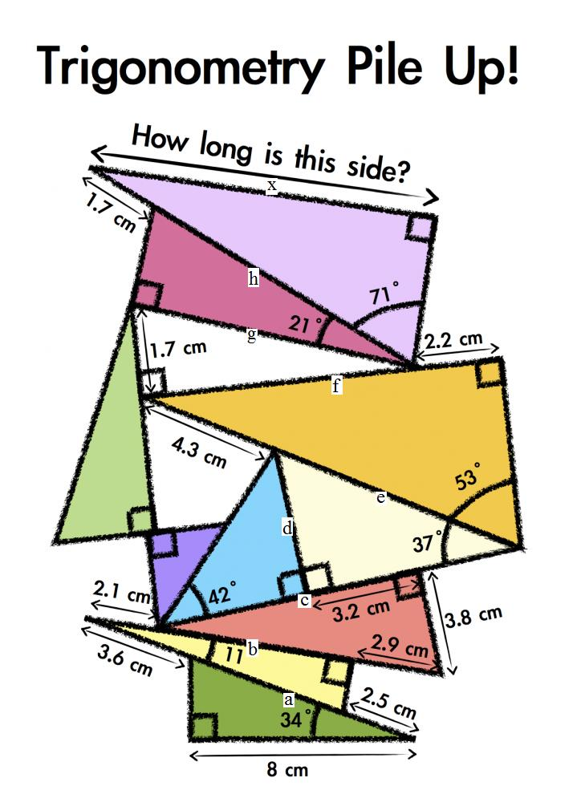

Slide 49
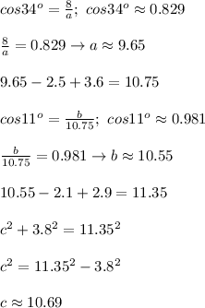
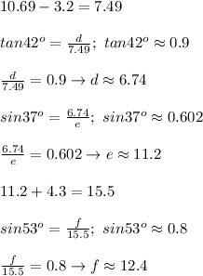
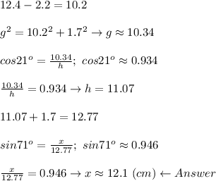

Slide 50
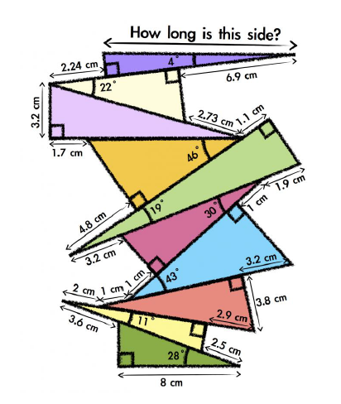

Slide 51
Right Triangle in Real-Life An Application to Right Triangle Trigonometry

Slide 52
Introduction
Objective: Solve real life situation problems using Right Triangle Trigonometry.
Instructions:
-Solve what is asked in the problems on a separate sheet of paper.
- Create a PPT, Go Animate, or other approved media to create your own word problem using Right Triangle Trigonometry.

Slide 53
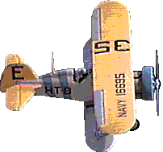
Example:
Fasten your seatbelts
A small plane takes off from an airport and rises uniformly at an angle of 6° with the horizontal ground. After it has traveled over a horizontal distance of 800m, what is the altitude of the plane to the nearest meter?
x
6°
800m

Slide 54
Solution:
x
Let x = the altitude of the plane as it travels 800m horizontally
Since we have the values of an acute angle and its adjacent side, we will use
6°
800m
x
6°
800m

Slide 55
Let us solve
Answer:
The altitude of the plane after it has traveled over a horizontal distance of 800m is 84m.

Slide 56
Let us solve some problems
Sail away
A ship sailed from a port with a bearing of S22°E. How far south has the ship traveled after covering a distance of 327km?
327km
x
22°

Slide 57
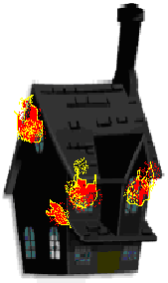
Emergency!!!
A ladder on a fire truck can be turned to a maximum angle of 70° and can be extended to a maximum length of 25m. If the base of the ladder is mounted on the fire truck 2m above the ground, how high above the ground will the ladder reach?
25m
70°
2m

Slide 58
Good Morning
From the tip of a shadow by the vertical object such as a tree, the angle of elevation of the top of the object is the same as the angle of elevation of the sun. What is the angle of elevation of the sun if a 7m tall tree casts a shadow of 18m?
7m
Θ
18m

Slide 59
Happy Landing
A plane is flying at an altitude of 1.5km. The pilot wants to descend into an airport so that the path of the plane makes an angle of 5° with the ground. How far from the airport (horizontal distance) should the descent begin?
1.5km
5°
x

Slide 60
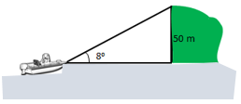
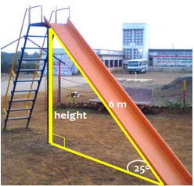
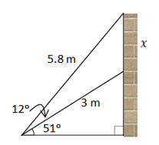
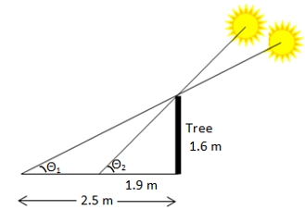

Slide 61
يقوم عامل بناء بتشييد حلبة منزلقة.
يبلغ طول الحلبة 6 أمتار.
تصنع الحلبة مع الأرض زاوية قياسها 25ᵒ
ما هو ارتفاع قمة الحلبة فوق سطح الأرض؟

Slide 62
لاحظ طاقم سفينة في عرض البحر مبنى على قمة جرف ارتفاعه 50 مترا وبزاوية 8ᵒ. ما هو بعد السفينة في عرض البحر؟

Slide 63
قف على بُعد 30 مترًا من شجرة (سارية علم أو مبنى) واستخدم كلينومتر (مقياس المَيْل) لإيجاد زاوية الارتفاع إلى أعلى الشَّجرة. ثمَّ استخدم حساب المثلَّثات لإيجاد ارتفاع الشَّجرة.

Slide 64
يبلغ طول سلَّم مداد 3 متر في أقلِّ طول له، وعند وضعه مقابل جدار يصنع زاوية قياسها 51ᵒ. عند تمديد السلَّم كليًّا إلى 5.8 متر تزداد الزَّاوية بمقدار12ᵒ. أوجد الارتفاع الَّذي يصل إليه السلَّم على الجدار عندما يتمُّ تمديده كليًّا؟

Slide 65
يتواجد طلبة صفِّ سعيد في الخارج لإجراء قياسات خاصَّة بمشروع الرِّياضيَّات. قام الطَّلبة بقياس طول شجرة فكان 1.6 متر، وبعد ذلك قاموا بقياس طول ظلِّ الشَّجرة فكان 2.5 متر. بعد وقت قصير، قاموا بقياس طول ظلِّ الشَّجرة مرة أخرى فكان 1.9 متر.
ما التَّغيُّر الذي حدث لزاوية الارتفاع إلى الشَّمس خلال هذه الفترة؟

Slide 66
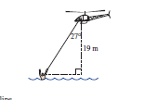
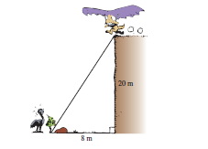
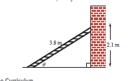

Slide 67
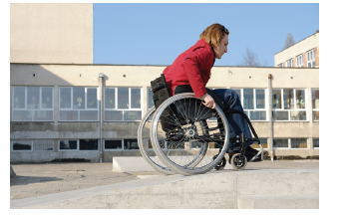
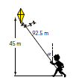

Slide 69
Assignment
Make your own Word Problems in Right Triangle Trigonometry.
HW Assignment
4 total problems: One each for Sin, Cos, and Tan. 4th problem should involve finding an angle.
Present and a complete solutions to each problem using PowerPoint presentation, Windows Movie Maker, GoAnimate or other approved media.
Must be approved by Teacher. Aziza before you begin.
DUE………………………
Assignments can be e-mailed. If using a web based program, then send link.

Slide 70
Development of Cofunction Identities
Given any right triangle, ABC, how does
the measure of B compare with A?
B =

Slide 71
Cofunction Identities
By similar reasoning other cofunction identities can be verified:
For any acute angle A,
sin A = cos(90° − A)
cos A = sin(90° − A)

Slide 72
Example: Write Functions in Terms of Cofunctions
Write each function in terms of its cofunction.
a) cos 38° = sin (90° − 38°) =
sin 52°

Slide 73
Solving Trigonometric Equations Using Cofunction Identities
Given a trigonometric equation that contains two trigonometric functions that are cofunctions, it may help to find solutions for unknowns by using a cofunction identity to convert to an equation containing only one trigonometric function as shown in the following example

Slide 74
Example: Solving Equations
Assuming that all angles are acute angles, find one solution for the equation:

