Slide 1


Slide 2
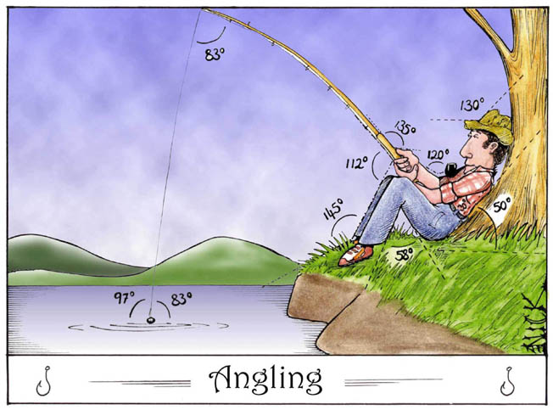

Slide 3
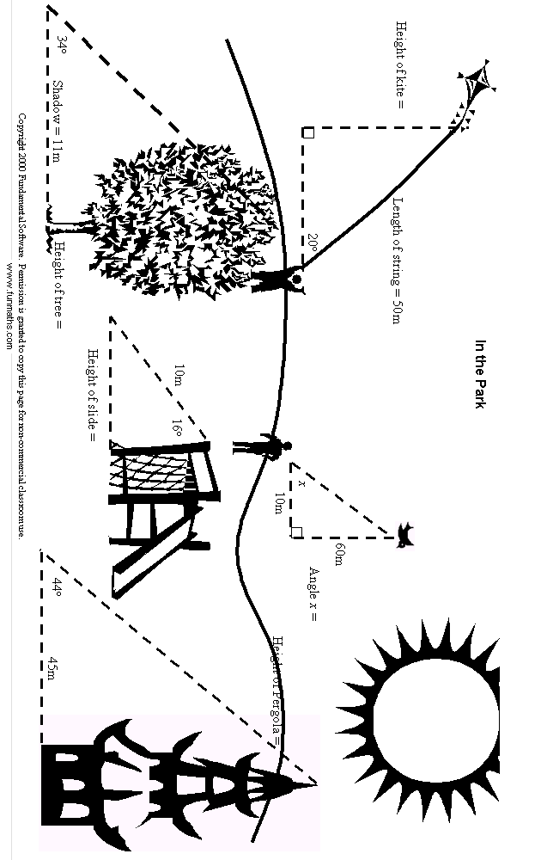

Slide 4
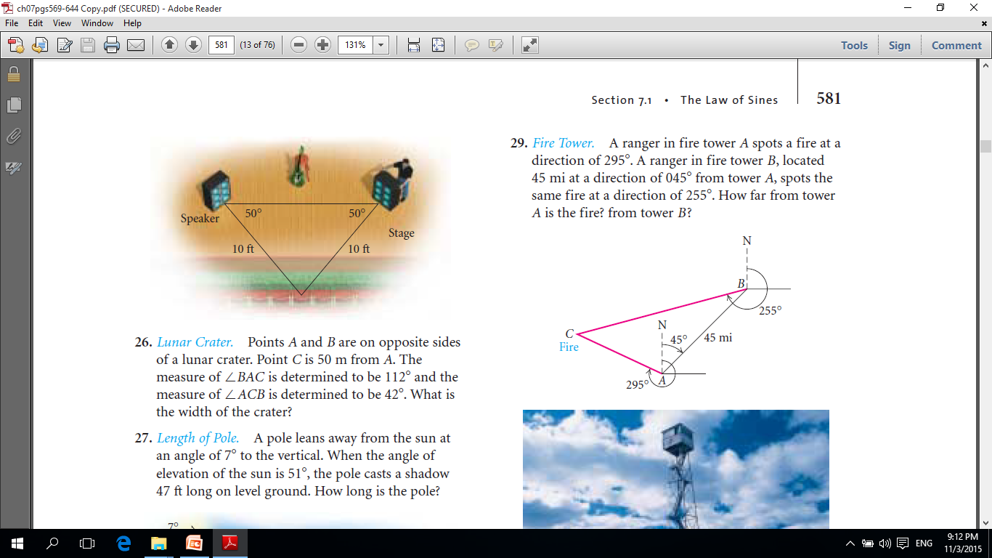
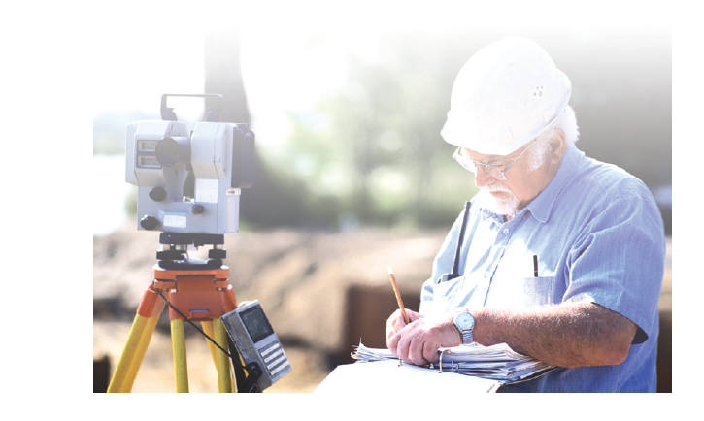
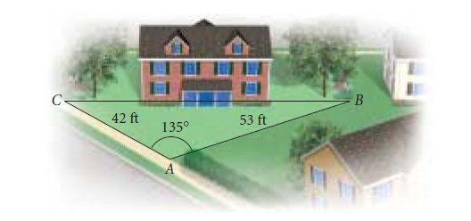
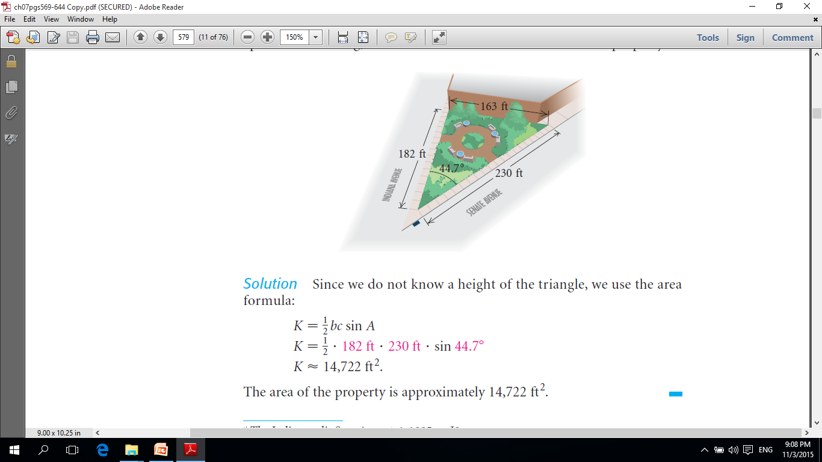
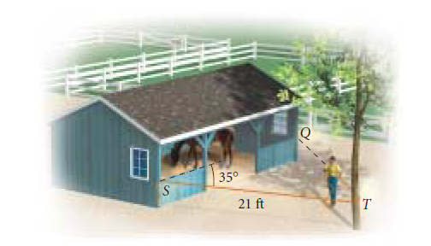
Area of a Triangle

Slide 5
INVESTIGATION – Area of a Triangle
Objectives for the next two lessons:
Know the standard labeling of a triangle
Derive a formula for the area of any triangle given two sides and the angle between them
Practice finding the area of non-right triangles

Slide 6
Label this triangle:

Slide 7
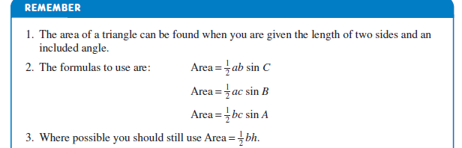
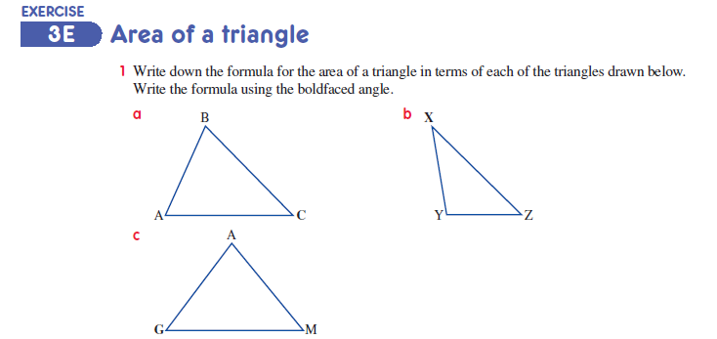

Slide 8
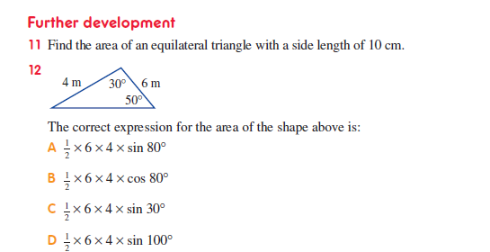

Slide 9
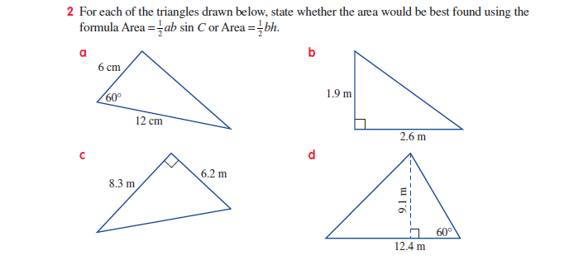

Slide 10
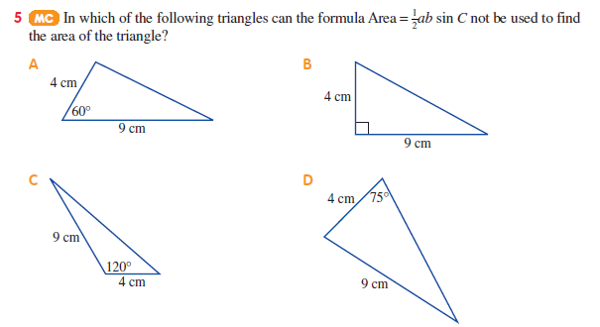

Slide 11
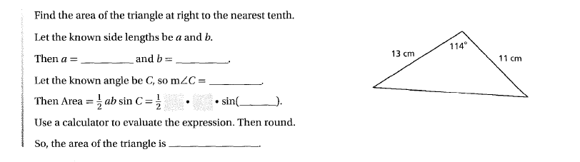
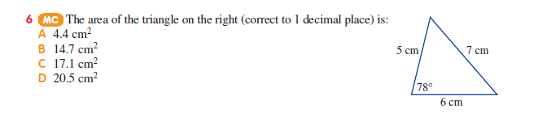

Slide 13
Area of a triangle
- can be found using trig when two sides and the angle between the sides (included angle) are known
Area = ½abSinC
e.g. Calculate the following area
C
9 m
b
Area = ½×8×9×Sin39
39°
Area = 22.7 m² (1 d.p.)
52°
8 m
a
89°
Re-label the triangle to help substitute info into the formula
Calculate size of missing angle using geometry (angles in triangle add to 180°)

Slide 14
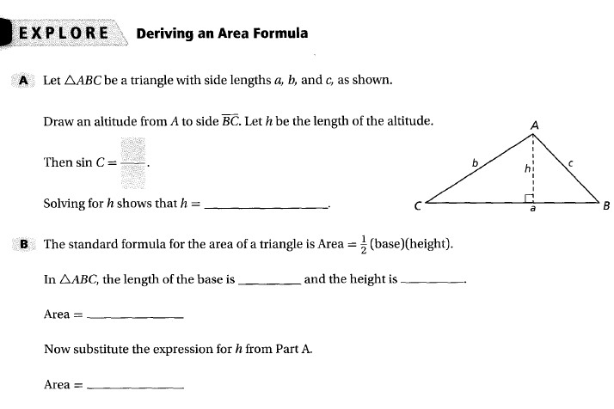

Slide 15
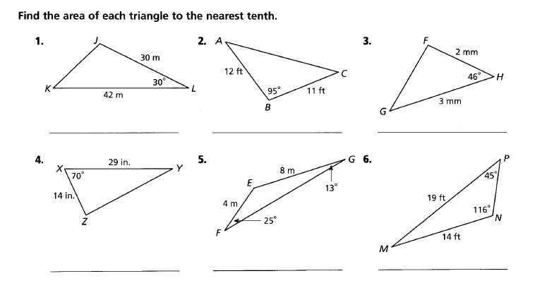

Slide 16
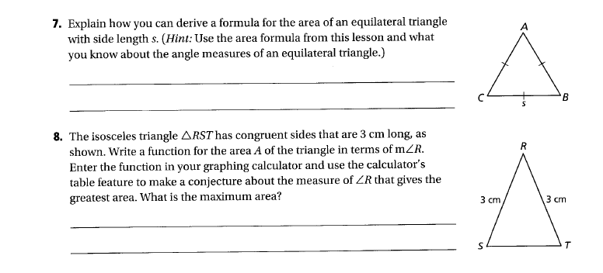

Slide 17
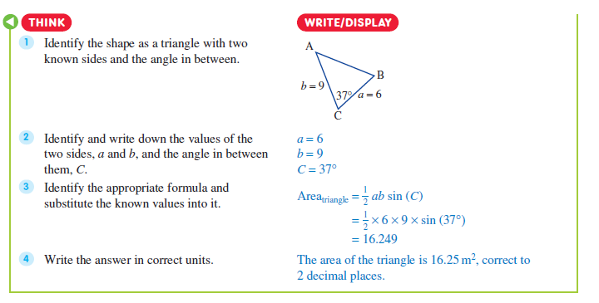

Slide 18
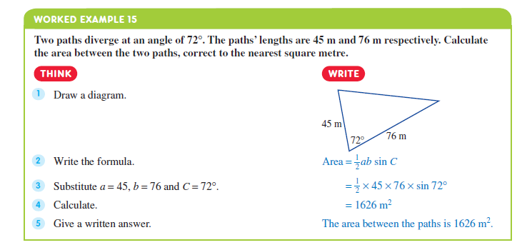

Slide 19
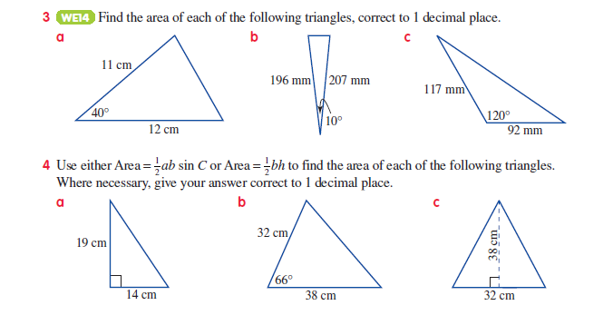

Slide 21
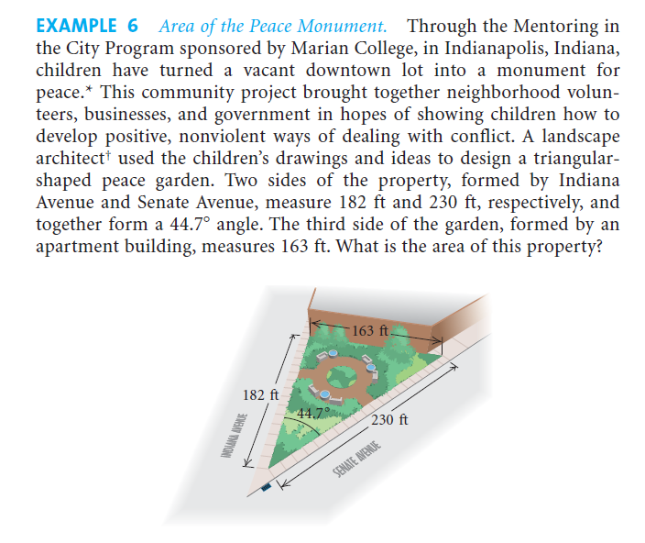

Slide 24
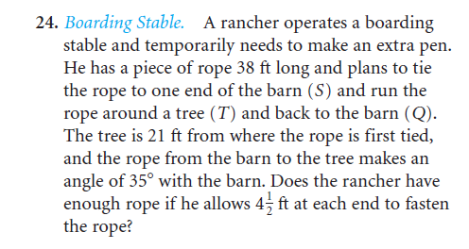

Slide 25
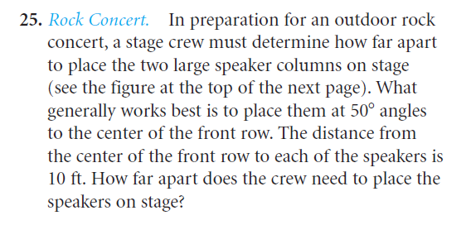

Slide 26
The Sine Rule

Slide 27
Objectives:الأهداف
to state the formula of sin-Rule
2. to recognize the cases in which we can use sin-rule
3. to solve practical problems
using sin-Rule

Slide 28
When to use the law of sins formula?
SSA
SAA
ASA
Law of Sines:
Two angles and a side (AAS or ASA); two sides and a non-included angle (SSA).

Slide 30






B
53º
a
A
62º
5 cm
C

Slide 31
The hole at a golf course is 210 m long from the tree to the hole in a direct line . Ahmad hit his first shot at angle of 15 off the direct line to the hole. His second shot landed in the hole if the angle between his 1st shot and 2nd shot was 105 how long was his 2nd shot?
اذا كانت حفرة الغولف على بعد 210 م من الشجرة على خط مستقيم . اذا ضرب احمد ضربته الأولى بزاوية ( ْ 15 ) عن الأفقي . وضربته الثانية استقرت في الحفرة . اذا كانت الزاوية بين ضربته الاولى وضربته الثانية كانت ( ْ 105 ) . ما هي المسافة التي قطعتها الضربة الثانية

Slide 32




Find the length of the 2nd shot

Slide 33
The diagram represents points D and E from which the lines of sight to a tree top at T make angles of 24 and 49 respectively , with DE. The length of DE is 53 m . calculate the height of the tree to the nearest tenth of meter,
الشكل المجاور يمثل الموقعين D , E حيث تم رصد أعلى الشجرة . كانت زوايا الارتفاع (42ْ ) ( 49ْ) على التوالي مع الخط DE . اذا كان طول DE (53 م ) . احسبي ارتفاع الشجرة لأقرب منزلة عشرية.

Slide 34







Find the height of the tree
25˚
d
h
53 m

Slide 35
Law of Cosines

Slide 36
Objectives:الأهداف
to state the formula of Cos-Rule
2. to recognize the cases in which we can use Cos-rule
3. to solve practical problems
using Cos-Rule

Slide 37
When to use the law of Cosines formula?
SSS
SAS
Law of Cosines: Three sides (SSS); two sides and an included angle (SAS).]

Slide 39
